Slide 1


Sputum Sample Collection

Slide 2
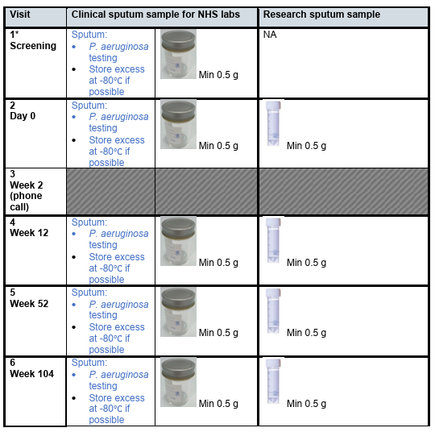
Laboratory Manual Sample Collection
Visit 1 clinical sputum sample is not needed if the participant has met the inclusion criteria and had a new positive P. aeruginosa sputum within the 6 months prior to randomisation
Two sputum samples will be collected at visits 2, 4, 5 & 6:
One clinical research sample for P. aeruginosa testing at local NHS labs (excess sample to be stored at site, if possible)
One research sputum sample which will be shipped fresh to research labs for analysis (either posted from site on day of visit or posted by participant post-visit)

Slide 3
Sputum sample collection clinical sputum sample
Sputum sample collection
Clinical Sputum Sample
To be collected as per lab manual & tested through local NHS labs (visits 2, 4, 5 & 6)
NHS microbiology culture for P. aeruginosa status
If possible, store excess sample at -80°C. Excess samples to be shipped to research team laboratory at end of trial
Clinical sputum sample results to be recorded on eCRF

Slide 4
Sputum sample collection research sputum sample
Sputum sample collection
Research Sputum Sample
Visit collection
If possible, to be collected as per lab manual during visits (visits 2, 4, 5 & 6)
If collected during visit, research team to post sample on day of visit to research team labs, using postage box & postage label provided
Visits to be scheduled Monday – Thursday
Participant collection
If not possible to collect sample during visit, provide participant with:
sputum pot
postage box (attach postage label)
postage instructions
postal form (part 1 completed by research team)
Participant will post sample to research labs, using pre-labelled postage box provided
All research samples will be processed by research team laboratory

Slide 5
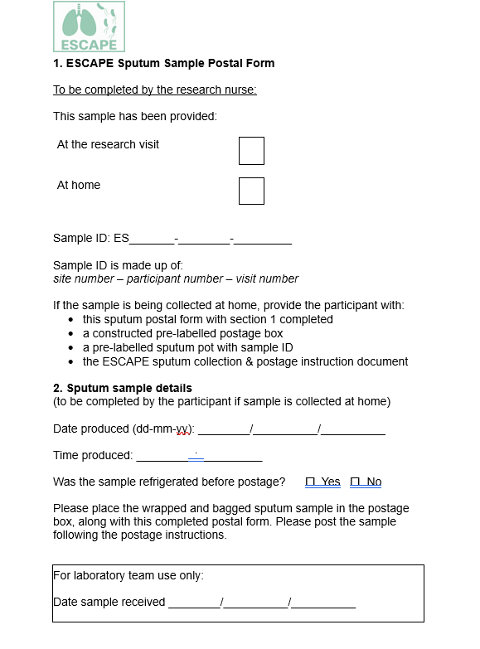
Sputum postal form
Part 1 to be completed by the research team
Sample ID = participant ID + visit number
01-03-02 is site 01, participant 03, visit 2
Part 2 to be completed by research team if sample collected during visit
Part 2 to be completed by participant if sample is being collected at home, following the visit

Slide 6
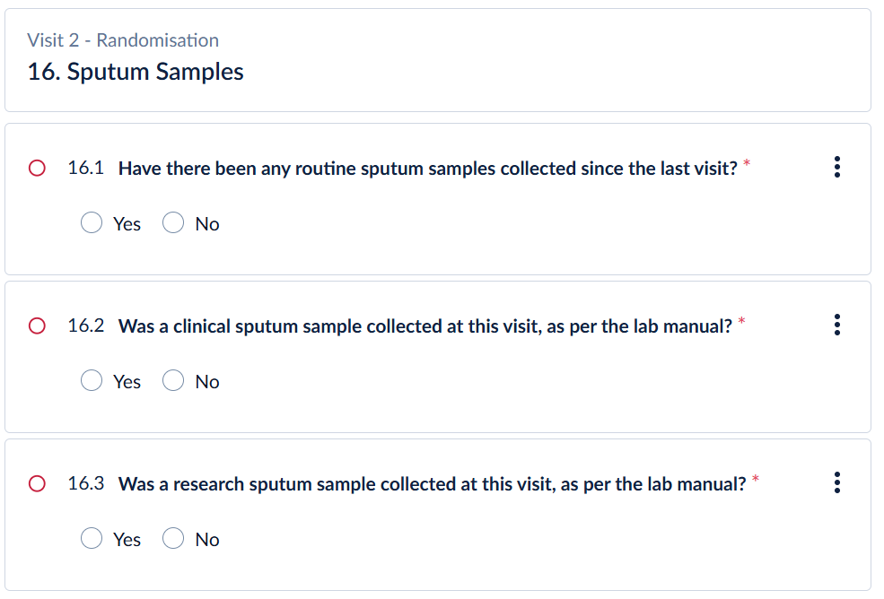
Recording sputum samples on trial database
At visits 2, 4, 5 & 6:
Samples taken routinely, not part of the trial, to be tested by NHS labs
Samples taken as part of the trial, to be tested by local NHS labs
Samples taken as part of the trial,
to be tested by Dundee research lab

Slide 7
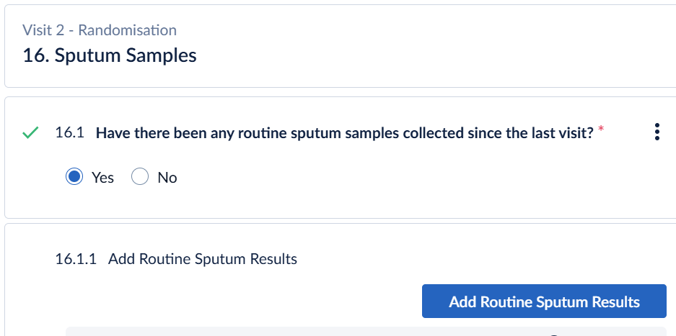
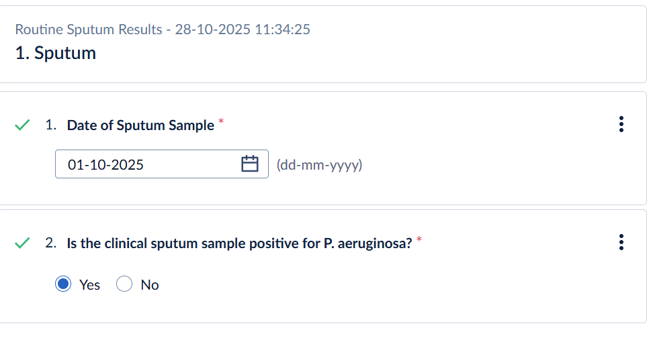
Recording routine sputum sample results
If there have been any routine NHS sputum samples since the participants previous visit, select “yes” and then “add routine sputum results”
This will open a repeating data form
Record date of sample and positive/negative for P. aeruginosa
This data is required for trial outcome “Time to reinfection”

Slide 8
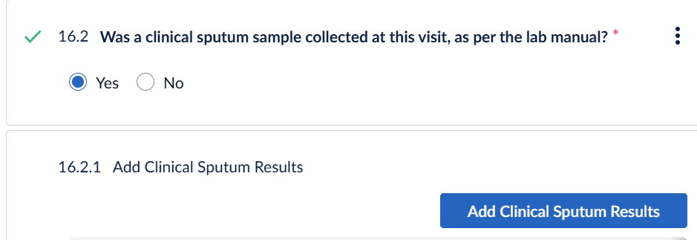
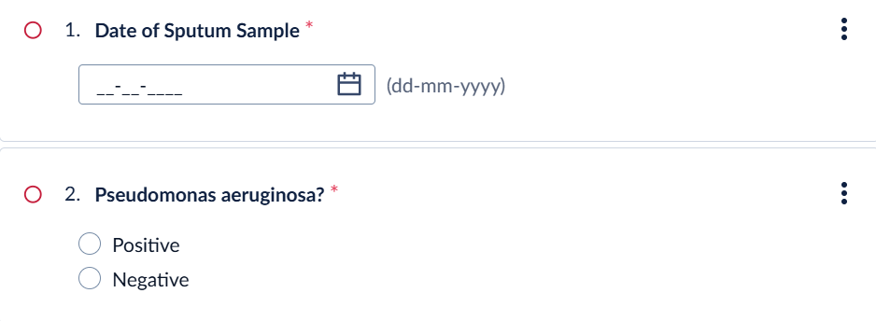
Recording clinical sputum sample results
Collect a clinical sputum sample for visits 2, 4, 5 & 6 and send to local NHS microbiology for P. aeruginosa testing
Record date of sample and positive/negative for P. aeruginosa

Slide 9
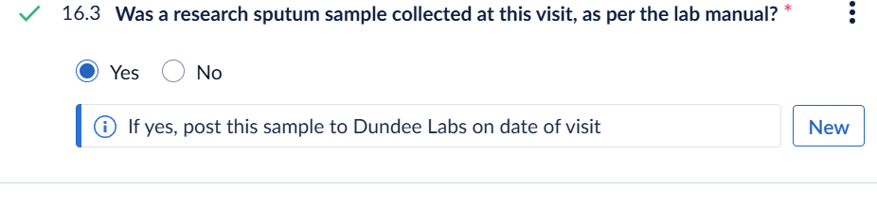
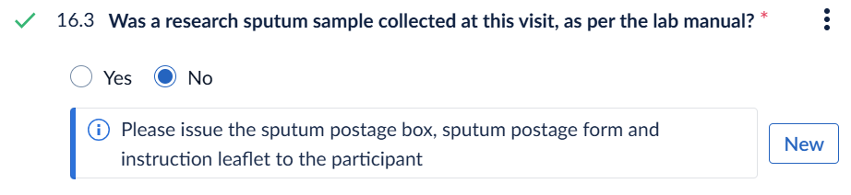
Recording research sputum sample collection
If the participant is able to produce a second sputum sample during the visit:
If the participant is not able to produce a second sputum sample during the visit:
Sample log
Record all samples collected on the eCRF & on the sample log provided
Separate sample log for research sputum sample collection and excess clinical sputum sample collection

Slide 10
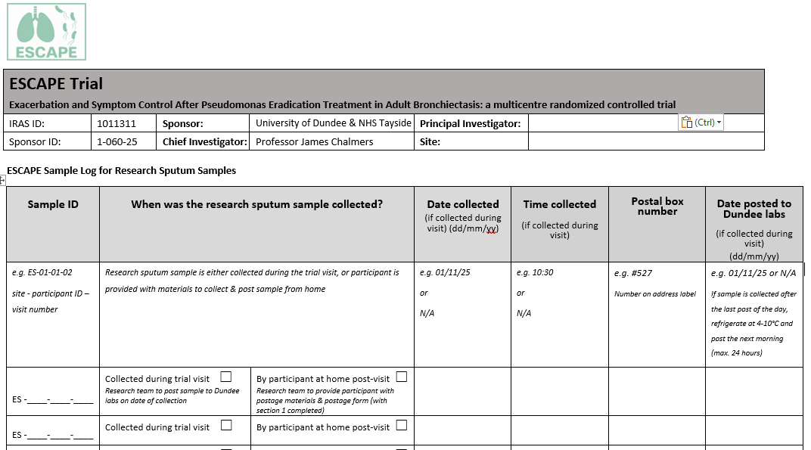
Research sputum sample log

Slide 11
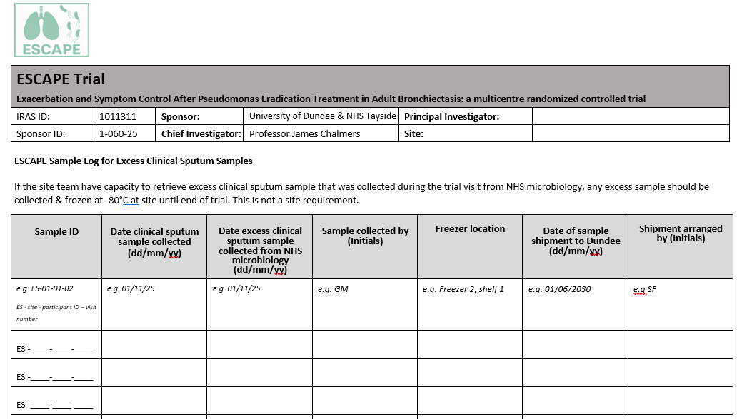
Excess clinical sputum sample log

