Slide 1


Breach Reporting

Slide 2
What is a breach?
What is a breach?
Any departure from:
  Approved Protocol
  Conditions of approvals
  Principles of GCP
  Written procedures (SOPs)
  Regulatory requirements
  Insurance cover
  Contractual obligations
  Confidentiality and GDPR
Our Sponsor does not recognise deviations – all deviations should be classified as breaches and reported.

Slide 3
Breach reporting
Breach reporting
Breach reporting is the responsibility of the site team
Breach report is made directly to the Sponsor
The breach reporting form must be downloaded from TASC website each time it is required, to ensure you are using a correct version
The form can be found under TASC SOP59:
https://www.dundee.ac.uk/tasc/policies-sops-templates/study-progress
Email breach report form to tascpotentialbreach@dundee.ac.uk & copy ESCAPE-TM@dundee.ac.uk
Email title: ESCAPE breach report (number) (site name)
Ensure correct breach numbering is used by referring to the site Breach Log
The Sponsor will close and categorise the breach form and send a copy back to the site team
Every breach must be documented on the Breach Log in the site file
Each closed breach report must be filed in the ISF

Slide 4
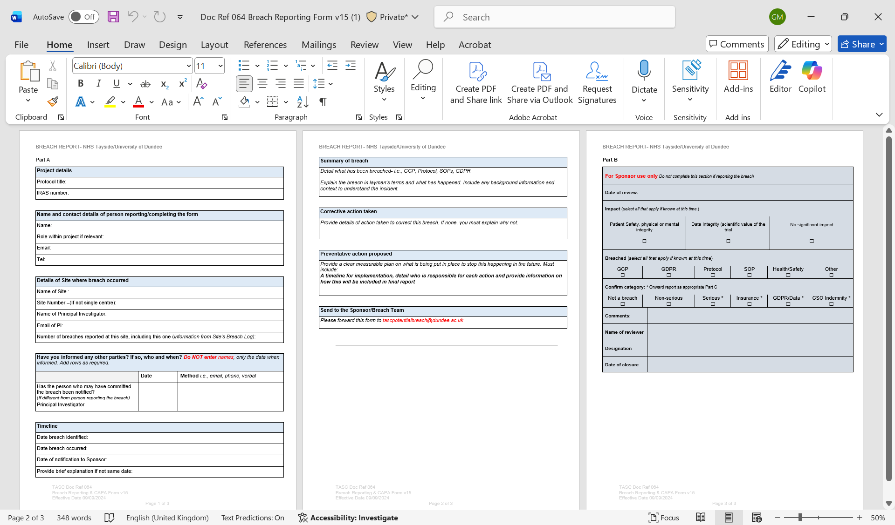
Breach report screenshot

Slide 5
Corrective And Preventive Action (CAPA)
Corrective And Preventive Action (CAPA)
Corrective
  What did you do to fix it?
Preventive
  Preventive action is to stop the problem from happening again, e.g checklist, training, new SOP, etc.

Slide 6
Are breaches always serious?
Are breaches always serious?
No.
The majority are technical breaches that do not result in harm to the trial participants or significantly affect the scientific value of the reported results
But…several non-serious breaches can become one Serious Breach as collectively they do have a detrimental impact
Therefore, ALL must be reported to Sponsor and documented on the Breach Log
If you are unsure, report anyway

