Slide 1


Adverse Event Recording & Reporting

Slide 2

Adverse Event Definitions
Term | Definition
Adverse Event (AE) | Any untoward medical occurrence in a consented participant which is not necessarily caused by or related to a medical product.
Adverse Reaction (AR) | An untoward and unintended response in a participant to an investigational medicinal product which is related to any dose administered to that participant. The phrase "response to an investigational medicinal product" means that a causal relationship between a trial medication and an AE is at least a reasonable possibility, i.e. the relationship cannot be ruled out. All cases judged by either the reporting medically qualified professional or the Sponsor as having a reasonable suspected causal relationship to the trial medication qualify as adverse reactions. It is important to note that this is entirely separate to the known side effects listed in the SmPC. It is specifically a temporal relationship between taking the drug, the half-life, and the time of the event or any valid alternative etiology that would explain the event.
Serious Adverse Event (SAE) | A serious adverse event is any untoward medical occurrence that: results in death is life-threatening requires inpatient hospitalisation or prolongation of existing hospitalisation results in persistent or significant disability/incapacity consists of a congenital anomaly or birth defect Other ‘important medical events’ may also be considered serious if they jeopardise the participant or require an intervention to prevent one of the above consequences. NOTE: The term "life-threatening" in the definition of "serious" refers to an event in which the participant was at risk of death at the time of the event; it does not refer to an event which hypothetically might have caused death if it were more severe.

Slide 3
Adverse event definition's part 2
Serious Adverse Reaction (SAR) | An adverse event that is both serious and, in the opinion of the reporting Investigator, believed with reasonable probability to be due to one of the trial treatments, based on the information provided.
Suspected Unexpected Serious Adverse Reaction (SUSAR) | A serious adverse reaction, the nature and severity of which is not consistent with the information about the medicinal product in question set out in the reference safety information: in the case of a product with a marketing authorisation, this could be in the summary of product characteristics (SmPC) for that product, so long as it is being used within it’s licence. If it is being used off label an assessment of the SmPCs suitability will need to be undertaken. in the case of any other investigational medicinal product, in the investigator’s brochure (IB) relating to the trial in question
Adverse Event Definitions

Slide 4
Adverse Events as defined in the Protocol
Adverse Events as defined in the Protocol
The treatments used are routinely used in NHS clinical practice. In clinical practice it would not be normal practice to report AEs unrelated to drug treatment or those expected as part of the normal course of the disease
Exacerbations of bronchiectasis will not be recorded as an adverse event
AEs will only be reported where, in the opinion of the investigator these are:
Events related to the background therapy of exacerbations
Events related to eradication treatment
Trial treatment overdose
Events leading to treatment discontinuation
Events related to trial procedures

Slide 5
Identifying Adverse Events
Identifying Adverse Events
Ask about the occurrence of AEs and hospitalisations at every visit
Review medical records for the occurrence of AEs and hospitalisations at every visit

Slide 6
Recording Adverse Events
Recording Adverse Events
Details of AEs must be recorded in the medical record for source data verification
All AEs must be recorded on the AE Log in the eCRF (Castor)
A paper worksheet has been provided for the site file (optional)
AEs must be assessed for severity and relationship to trial medication by the PI
AEs must be recorded from the time a participant consents to join the trial until the participant’s last trial visit
AEs must be signed by PI or delegated doctor
Unresolved AEs/SAEs at end of trial must be followed up until 30 days after participant’s last visit
Any SUSAR, that the investigator becomes aware of, must be reported to the Sponsor irrespective of how long after IMP administration the reaction has occurred
SUSARS will be followed until resolution, where a participant agrees to this

Slide 7
Assessment of severity of AEs:
Assessment of severity of AEs:
Mild: An event that is easily tolerated by the participant, causing minimal discomfort, and not interfering with everyday activities.
Moderate: An event that is sufficiently discomforting to interfere with normal everyday activities.
Severe: An event that prevents normal everyday activities.

Slide 8
Review of Adverse Events
Activity | Responsibility | Timing | Comments
Review medical records and questioning of participant for evidence of AEs at all visits. | Trial staff | All visits | Recorded on eCRF system.
Review of recorded AEs for causality and seriousness | PI (or delegate) | Within 7 days of recording | Recorded on eCRF and/or medical records.
Reporting SAEs - All SAEs need to be assessed and signed off by the PI or delegated doctor. | PI (or delegate) | Within 24 hours of becoming aware of SAE | Reported via the online Tayside Pharmacovigilance system
Reviewing of SAEs | Sponsor | Following receipt | Pharmacovigilance Committee
Reporting of SUSARs to MHRA | Sponsor | Within 7 days if life threatening or fatal. Within 15 days for others | Senior Research Governance Manager or delegate

Slide 9
Exacerbation recording
Exacerbation recording
The primary outcome is frequency of exacerbations (EMBARC definition) over 24 months.
Exacerbations of bronchiectasis are not classified as an Adverse Event.
Review symptoms with participant at each visit.
If the participant has had any signs or symptoms of pulmonary exacerbation since the last visit, then an “Exacerbation” form should be completed in the eCRF.
Important to complete an exacerbation form even if the participant only has one or two symptoms of an exacerbation.
A separate Exacerbation Record Form should be completed for each distinct exacerbation.
If symptoms have resolved for at least 48 hours before more symptoms develop then this should be classified as a new exacerbation.
Details of any exacerbations should also be recorded in the medical notes.
Exacerbation form will classify symptoms as a protocol defined exacerbation, non-protocol defined exacerbation or not an exacerbation.

Slide 10


TASC PV email
ESCAPE
Site Initiation Visit
Pharmacovigilance
  Pharmacovigilance manager: Tay.pharmacovigilance@nhs.scot

Slide 11
Reporting Serious Adverse Events
Reporting Serious Adverse Events
SAEs must be submitted through the online Tayside Pharmacovigilance System within 24 hours of becoming aware of the SAE
Severity, Seriousness and Causality to be assessed by a medically qualified professional.
PI or CI must review and sign off SAE reports
Site PIs should also notify the CI when submitting an SAE
If further information is required, this must be provided as soon as available in a follow up report
Team members delegated SAE reporting will receive PV database training
The PV database can be accessed here:
https://pharmacovigilance.hicservices.dundee.ac.uk/

Slide 12
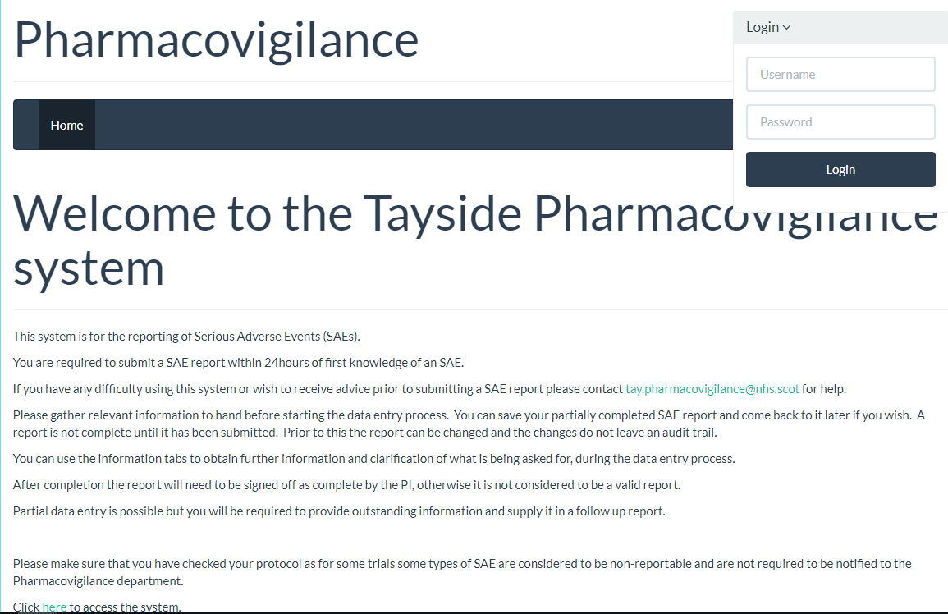
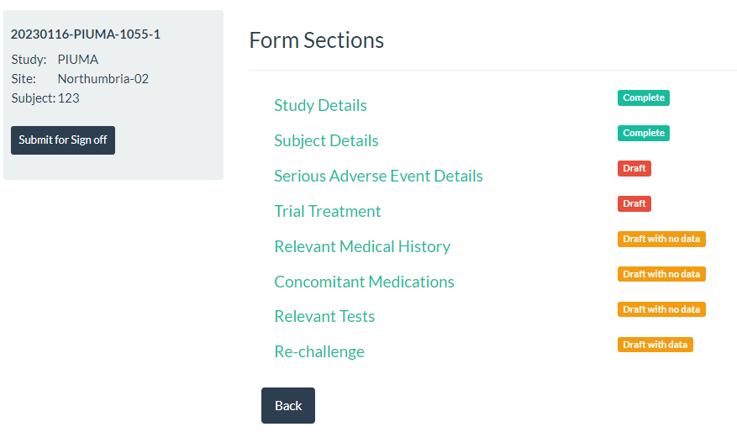
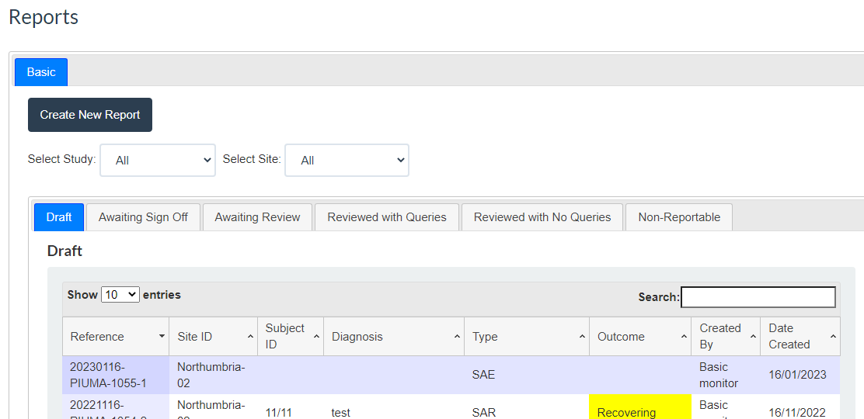
PV system
Notes:
Serious adverse events are notified to Sponsor through the online PV system.
SAE reports to be created by nursing staff or PI/CI – the system notifies the relevant individuals that an SAE has been reported, that it requires sign off (PI).
Everyone with SAE reporting responsibilities will require training on the system and this can be arranged through PV monitor.

Slide 13
Pregnancy reporting
Expectedness
  Expectedness is assessed by Sponsor.
  Pregnancy reporting
  Pregnancy forms are available on the TASC website: https://www.dundee.ac.uk/tasc/researchers/policies-sops-templates/sops-templates/pv-imp/
  Pregnancy notification form must be completed and reported via email within 14 days: Tay.pharmacovigilance@nhs.scot
Notes:
As you will find on TASC SOP 11 the Expectedness assessment is a Sponsor responsibility.
Pregnancy notification forms can also be found on the TASC website and should be sent to PV within 14 days of becoming aware.
Please make note of the correct email address – this can also be found on TASC SOP11

