Slide 1


Trial Discontinuation,
Withdrawal & Completion

Slide 2
Withdrawal from treatment – continue trial visits
Withdrawal from treatment – continue trial visits
The investigator may withdraw a participant at any time if it is in the best interest of the participant and treatment continuation would be detrimental to the participant’s well-being.
A full explanation will be provided.
Once the participant has been randomised, ask to complete trial visits as per the protocol, if appropriate.
This would allow for an intention to treat analysis.
Participants are free to refuse to do so.

Slide 3
Withdrawal from trial – stops all trial activity
Withdrawal from trial – stops all trial activity
Participants are free to withdraw at any time and are not obliged to give reason(s).
Make a reasonable effort to ascertain the reason(s), both for those who express their right to withdraw and for those lost to follow up, while fully respecting the individual’s rights.
If a participant withdraws and does not remain on the study, the Completion of Trial/Early Withdrawal form should be completed on the eCRF.

Slide 4
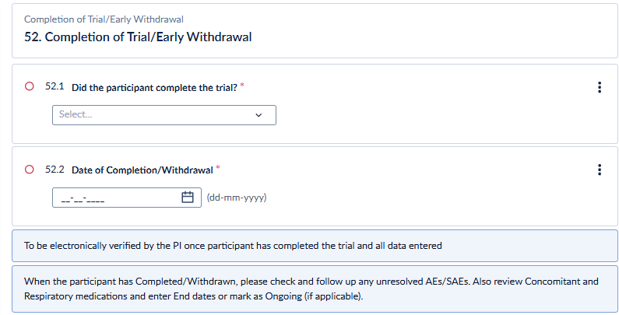
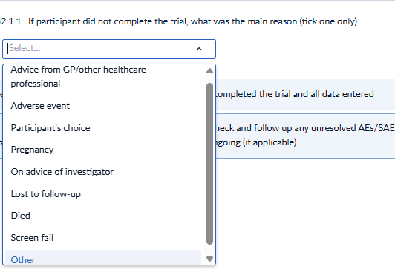
Completion of trial
Completion of Trial
If participant did not complete the trial, record reason:

