Slide 1


Concomitant Medications

Slide 2
Review of concomitant medications
Review of concomitant medications
Taken from medical records and participant reporting
Reported concomitant medications must be recorded in medical records for source data verification
Visit 1
Ask participants to bring their current prescription.
Take a copy, clarify if participant is actively taking all their prescription drugs, and score through any on the list which they are not currently taking.
File a copy of the prescription in the participant’s medical notes for SDV.
All other visits
Ask if there are any changes to medication since previous visit
Record changes in medical notes and eCRF
Excluded Medications
Please ensure at all visits that the participant is not taking any excluded medicines.

Slide 3
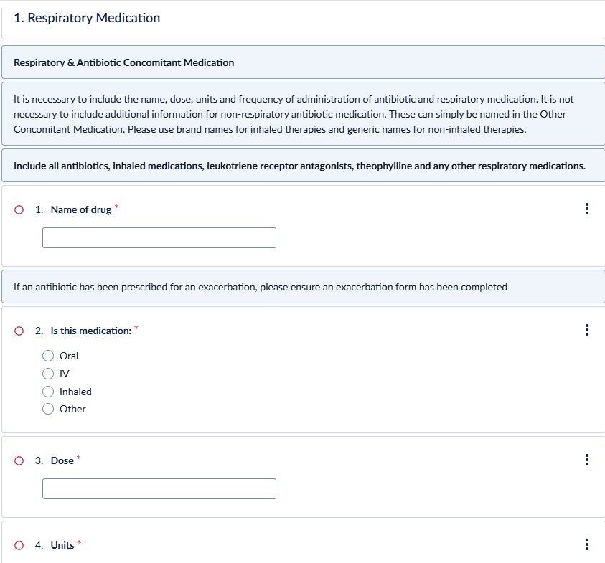
eCRF concomitant medications
Respiratory con meds:
all antibiotics, inhaled medications, leukotriene receptor antagonists, theophylline and any other respiratory medications
Brand name - no need to list combined medications separately

Slide 4
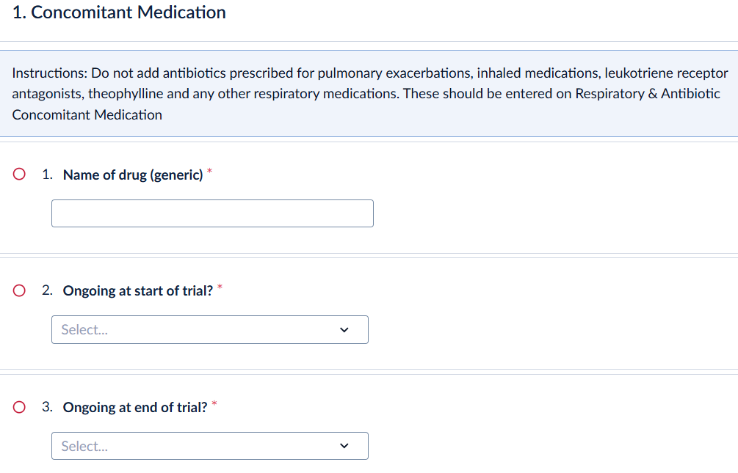
Ecrf Concomitant medications part 2
eCRF concomitant medications
Other con meds: less information required, generic name - ingredients of combined medications should be listed separately

Slide 5
eCRF
eCRF
At Visit 1 all medications should be ticked as ongoing at start of trial.
Any new medications started during the course of the trial should have a start date.
Any medications stopped during the participation in the trial should have an end date.
At the last visit all medications should have either an end date or ticked as “ongoing at end of trial”.
Any “background therapies” ongoing at the start of trial or prescribed at visit 2 should be recorded as a respiratory con med.

