Slide 1


Prescribing Trial Treatment

Slide 2
Treatment allocation
Treatment allocation
Participants randomised to one of two treatment pathways:
Background therapy (comparator) or eradication treatment (intervention)
Comparator | Background therapy only.
Intervention | P. aeruginosa eradication treatment consisting of systemic antibiotics (either oral or intravenous as clinically indicated) alongside or followed by inhaled anti-pseudomonal antibiotics for 3 months, in addition to background therapy.
Formulation, Dose, Route of Administration | As per British Thoracic Society Guidelines.
This trial is aimed at assessing efficacy, safety and cost effectiveness of P. aeruginosa eradication treatment compared with background therapy only in bronchiectasis in current clinical practice used in the UK.

Slide 3
Treatment pathways
Treatment pathways
Background therapy
Background therapy may consist of their existing bronchiectasis treatments such as airway clearance, bronchodilators, long term macrolide treatment or other symptomatic therapies e.g mucoactive drugs. Background therapy also includes administration of antibiotics if patients have symptoms of an exacerbation.
If the participant has no symptoms of an acute exacerbation and the investigator judges that antibiotic treatment is not required, no treatment is offered.
If the participant has an acute exacerbation or the investigator feels antibiotic treatment is required for symptomatic reasons, then an example oral antibiotic treatment would be ciprofloxacin 750mg twice daily for 14 days.
Background therapy is not pre-defined in the protocol are not classified as IMPs.
Participants in the comparator arm should not receive inhaled antibiotics during the first 3 months post randomisation.

Slide 4
Treatment pathways eradication
Treatment pathways
Eradication treatment
Eradication treatment consists of systemic antibiotics, usually administered for 2 weeks, followed by inhaled antibiotic treatment, in addition to background therapy.
British Thoracic Guidelines define P. aeruginosa eradication treatment as:
First line treatment antibiotic Ciprofloxacin 500 mg or 750 mg twice a day for 2 weeks
Second line treatment of IV antipseudomonal beta-lactam ± an IV aminoglycoside for 2 weeks
Followed by a 3-month course of a nebulised antipseudomonal antibiotic
A typical eradication regimen may consist of Ciprofloxacin 750mg twice daily for 14 days plus 3 months of inhaled Colistin.
Prescribing will be determined by the investigator following usual practice and the British Thoracic Society Guidelines
The eradication treatment will be determined by the investigator with no influence from the trial team.
The antibiotics to be prescribed for the eradication treatment are defined in protocol as IMPs (protocol table 1), no other eradication trial treatments can be prescribed.

Slide 5
Eradication treatment options
Eradication Treatment Options
Manufacturer | Oral antibiotic | Dosage | Duration
Aurobindo Pharma - Milpharm Ltd. | Ciprofloxacin | 500 mg or 750 mg | 14 days, twice daily
 | IV antibiotics | Dosage | Duration
Bowmed Ibisqus Limited | Piperacillin/Tazobactam | 4 g / 500 mg | 14 days, three or four times daily
Wockhardt UK Ltd | Ceftazidime | 2 g | 14 days, three times daily
Pfizer Limited | Meropenem | 1 g or 2 g | 14 days, three times daily
Bristol Myers Squibb Pharmaceuticals Limited | Aztreonam | 1 g or 2 g | 14 days, four times daily or 14 days, three times daily
Merck Sharp & Dohme (UK) Limited | Ceftolozane / tazobactam | 1g / 0.5 g or 2g / 1g | 14 days, 3 times daily
ADVANZ Pharma | Gentamicin | Not specified, determined by weight | Not specified
Hospira UK Ltd | Tobramycin | Not specified, determined by weight | Not specified
Hameln Pharma Ltd | Amikacin | Not specified, determined by weight | Not specified
InfectoPharm Ltd | Fosfomycin | 12–24 g daily dose | 14 days, two to three times daily
Bowmed Ibisqus Limited | Levofloxacin | 500 mg | 14 days, once or twice daily
 | Nebulised antipseudomonal antibiotics
Teva UK Limited | Colistin | 2 MU | 3-months, twice daily
ADVANZ Pharma | Gentamicin | 80 mg | 3-months, twice daily
Sun Pharmaceutical Industries | Tobramycin | 300 mg | One month, twice daily or 3-months, twice daily
Protocol Table 1 defines IMP prescribing options for eradication treatment
Equivalent licensed brands or different doses of these antibiotics may be used during the trial, depending on clinical need and local availability

Slide 6
Issuing trial medication
Issuing Trial Medication
Medications to be issued through routine NHS prescription
Prescription documented in medical notes
No clinical trial pharmacy required
No clinical trial labelling required
No IMP accountability required from research team, medications will be dispensed & recorded by NHS pharmacy
Eradication treatment compliance will be recorded verbally at visits 3 & 4 and documented on eCRF

Slide 7
Trial restrictions
Trial Restrictions
Dosage modifications will be at the discretion of the prescribing clinician as per routine clinical practice
Any other chronic treatment for the management of bronchiectasis can be continued and there will be no restrictions to how participants can be managed
There are no prohibited medications
Participants in the comparator arm (background therapy only) should not receive inhaled antibiotics during the first 3 months post randomisation
However, if inhaled antibiotics are required clinically as part of usual care these will not be withheld and the participant would crossover from comparator arm to eradication arm
This should be recorded in participant notes & on eCRF, as a respiratory Concomitant Medications

Slide 8
Oral/IV treatment prior to randomisation
Oral/IV Treatment Prior to Randomisation
Previous treatment with oral or IV antibiotics is not an exclusion.
Potentially eligible participants can be randomised if they are currently taking a course of oral or IV antibiotic and the antibiotic is listed in Table 1: ESCAPE trial IMP.
If the participant is randomised to background therapy only, they should continue this course of antibiotic as background therapy.
If the participant is randomised to eradication treatment, the start date of the oral or IV antibiotic would be considered the start date of eradication treatment.

Slide 9
Recording eradication treatment on eCRF
Recording Eradication Treatment on eCRF
Medications prescribed at visit 2 for the eradication treatment must be recorded under the “Trial Treatment” tab on the eCRF
This will record each trial treatment in a separate form (i.e. one oral or IV antibiotic + 1 inhaled antibiotic)
Only the medications prescribed for the eradication treatment at visit 2 should be recorded as “trial treatment”
Any other medications prescribed outside of the eradication treatment should be recorded as a respiratory Concomitant Medications

Slide 10
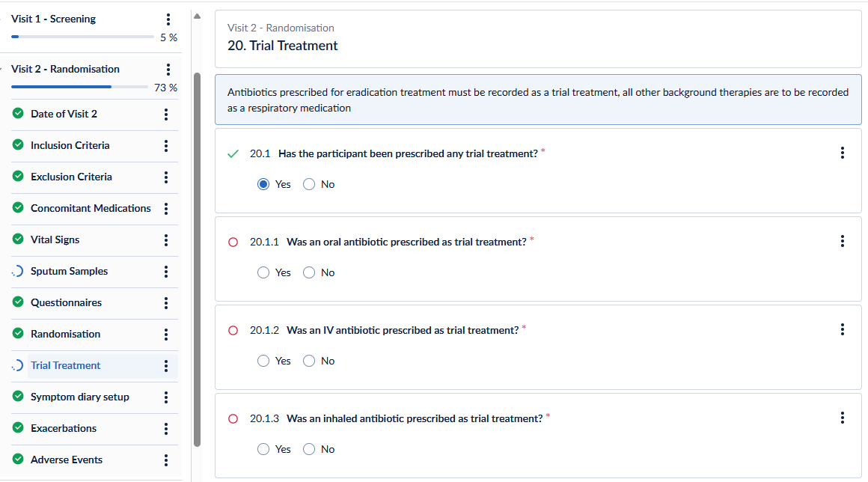
Recording eradication treatment on Ecrf visit 2 trial treatment
Recording Eradication Treatment on eCRF
Visit 2 “Trial Treatment”

Slide 11
Recording eradication treatment on Ecrf visit 3 and 4 verbal checks
Recording Eradication Treatment on eCRF
Eradication trial treatment compliance to be confirmed verbally at visit 3 and visit 4 and recorded on Castor
Treatment compliance checks at visit 3 & 4:
Record treatment end date
Whether treatment was taken for full period prescribed
If not, reason treatment not completed
Whether any doses missed
If yes, number of days with missed doses

Slide 12
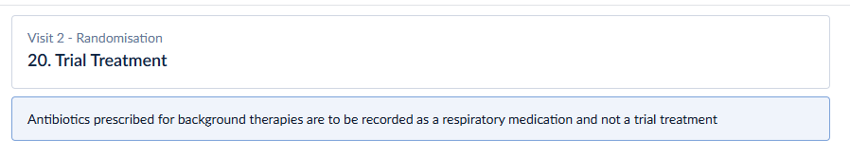
Recording Background Therapies on eCRF
Any medications prescribed for background therapy at visit 2 should be recorded on a Con Meds form on the eCRF
These should not be entered as “trial medication”
If participant is randomised to “Background therapy only”, the following message will appear on eCRF for trial treatment:

