Slide 1


Randomisation

Slide 2

Randomisation requirements
Randomisation Requirements
Delegated to randomise on Delegation Log
Randomisation training completed – this presentation & documented on Training Log
Eligibility Form reviewed & signed by PI/delegate
Internet access
TRuST log-in
Participant ID
Printer

Slide 3
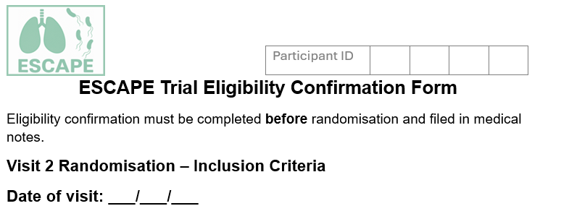
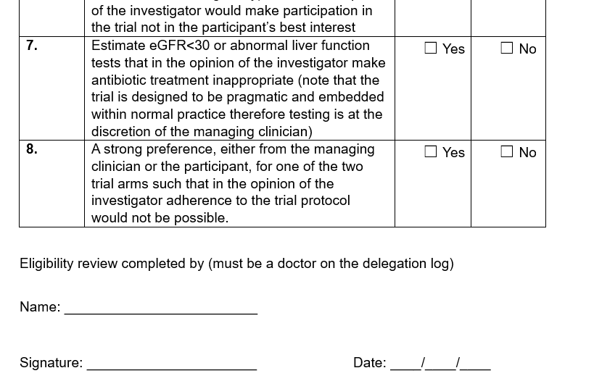
Completion of Eligibility Form
Complete the paper eligibility form to ensure participants is eligible to be randomised.
This must be reviewed & signed by a delegated doctor before randomisation takes place.

Slide 4
TRuST – Tayside Randomisation System
Web-based randomisation system
TRuST for ESCAPE will be used for randomisation only
Trial treatments will be prescribed following usual practice, clinical trial pharmacy will not be involved
ESCAPE is unblinded, team members delegated randomisation will receive the participant randomisation allocation
The delegated doctor will prescribe treatments based on the randomisation allocation
The participant will also be made aware of their treatment allocation

Slide 5
TRuST Access
TRuST Access
TRuST accounts will be created following receipt of a signed delegation log
TRuST accounts will be created but not activated until site is ready to go live
Each user will receive an email when the account is created (the user account may not be live at this stage)
A second email will be sent when the account is activated
TRuST can be accessed directly: https://trust.hicservices.dundee.ac.uk/Account/Login
If you forget your password, click on “Forgotten Password” and enter your email as your username.

Slide 6
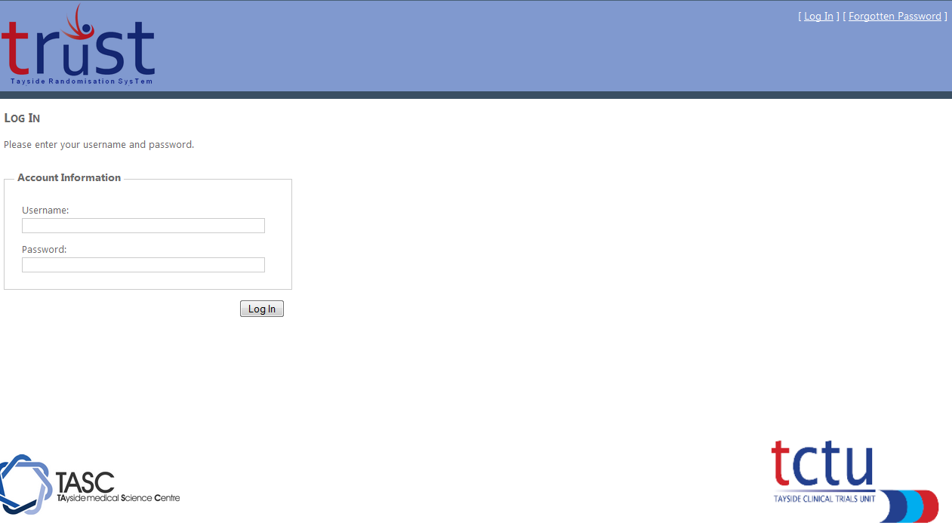
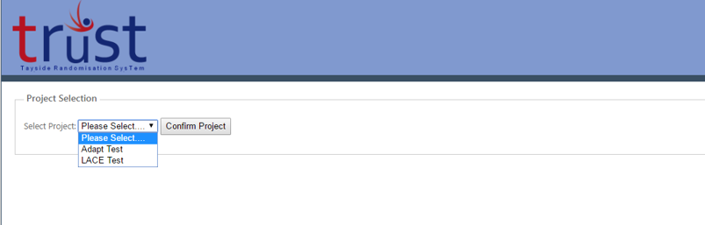
Logging into TRuST
Log in with your details; on first login you will be asked to change your password
If you forget your password, click the forgotten password link and your new password will be emailed to you
For staff with multiple projects on TRuST select the ESCAPE trial from the dropdown menu.

Slide 7
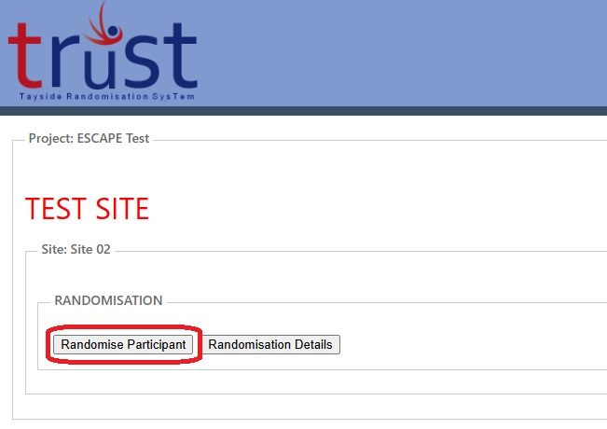
Randomising a participant
Randomising a participant
Click “Randomise Participant” button

Slide 8
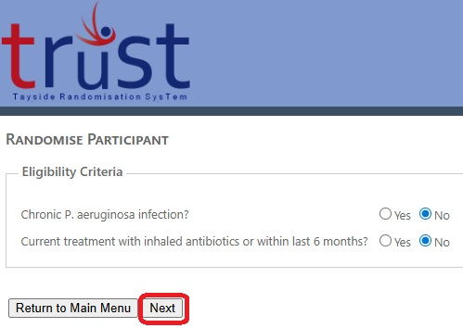
Randomising a participant eligibility
Randomising a participant – confirmation of eligibility
Complete eligibility criteria questions
Click on “Next” button

Slide 9
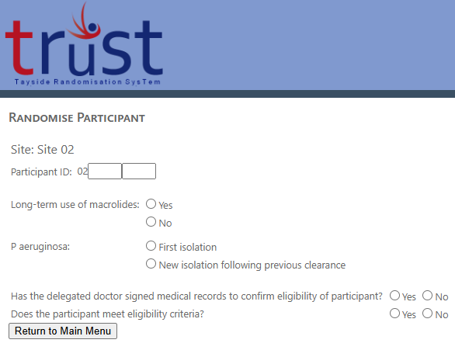
Randomising a participant part 2
Randomising a participant
Add participant ID (site ID is prepopulated)
Complete stratification questions
Dr sign off must be “Yes”
Eligibility must be “Yes”

Slide 10
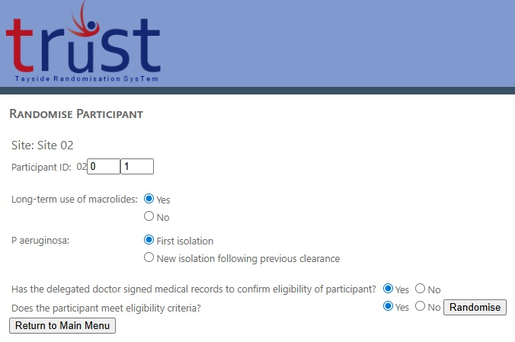
Randomising a participant part 3
Randomising a participant
When both consent form and eligibility criteria have been completed as “Yes” the “Randomise” button will appear.
Click on “Randomise” button

Slide 11
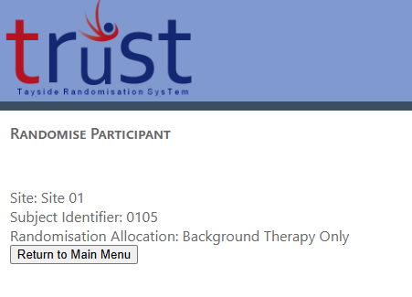
Randomising a participant part 4
Randomising a participant
The screen will now display the
randomisation allocation.
The person performing randomisation will receive a confirmation email
Print this email and save in the site file

Slide 12
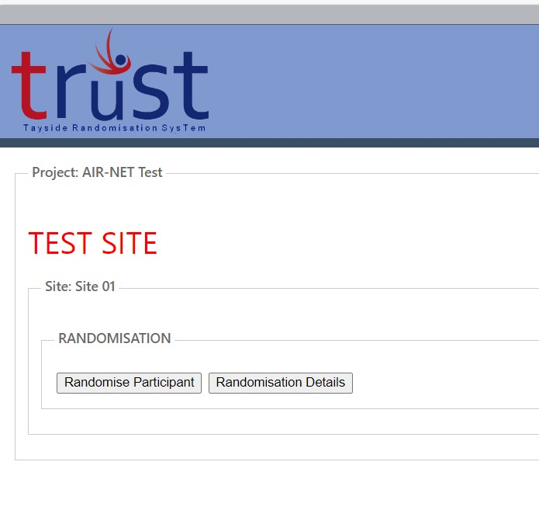
Randomisation details
Randomisation Details
Main menu:
Click “Randomisatin Details” button

Slide 13
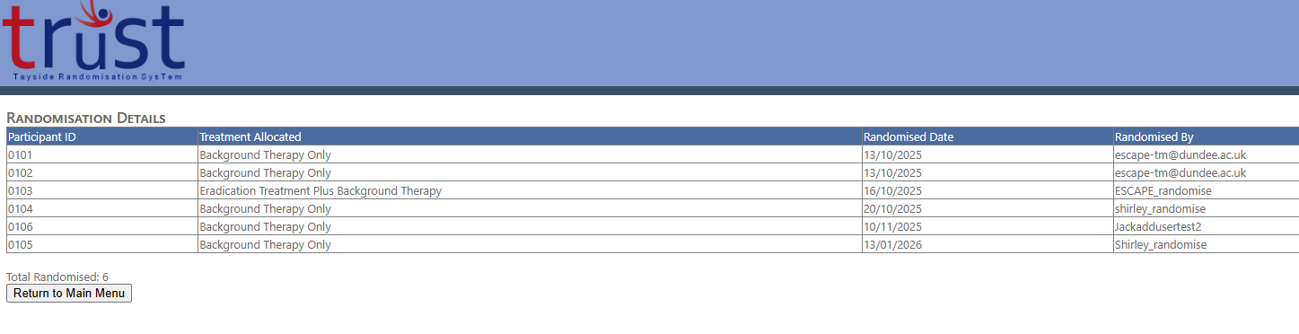
Randomisation details part 2
Randomisation Details

Slide 14
Emergency Randomisation

Slide 15
Emergency randomisation
Emergency Randomisation
In cases where site team cannot access TRuST (e.g. no internet) the trial management team may be able to provide emergency access
Contact the trial manager with any TRuST access issues
The trial team will complete Emergency Randomisation Form
Site team will confirm eligibility questions to the trial team
Trial team will perform the randomisation
Site team will receive a copy of the randomisation email with treatment allocation

Slide 16
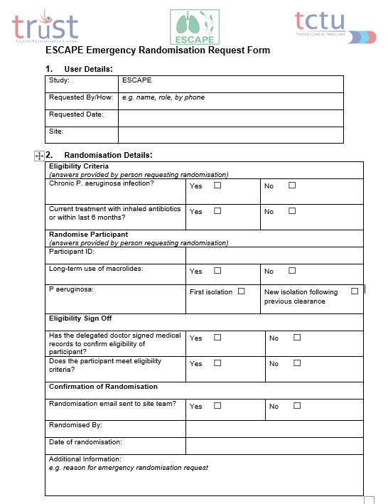
Emergency Randomisation Form
To be completed by trial management team, with information provided by site team

Slide 17
Contact the trial management for any randomisation queries
ESCAPE Trial Management Team: ESCAPE-TM@dundee.ac.uk
Phone: 01382 381955
Mob: 07818 511117

