Slide 1


Trial Assessments

Slide 2
Visit activities
 | Visit 1 | Visit 2 | Visit 3 | Visit 4 | Visit 5 | Visit 6
 | Screening | Randomisation | Phone call | Follow-up | Follow-up | Final Visit
Informed consent | X
Eligibility check | X | X
Medical history | X
Demographics | X
Concomitant medications | X | X | X | X | X | X
Pregnancy test, if required | X
ECG | X
Weight & Height | X
Temp, BP, Pulse O₂ sats | X | X |  | X | X | X
Physical examination | X
BSI score | X
Clinical sputum sample | X* | X |  | X | X | X
Research sputum sample |  | X |  | X | X | X
QoL-B |  | X |  | X | X | X
CAAT |  | X |  | X | X | X
EQ-5D-5L |  | X |  | X | X | X
BEST diary ** (continuous throughout the trial) |  | X
Review of routine sputum culture results for P. aeruginosa |  | X | X | X | X | X
Randomisation |  | X
Prescription for trial |  | X
Exacerbation recording |  | X | X | X | X | X
Review/reporting of participant AEs/SAEs |  | X | X | X | X | X
Drug compliance |  |  | X | X

Slide 3

Eligibility checks
Eligibility checks
Demographic details
Ensure participants are 18 years or over on the date of randomisation
History of Bronchiectasis
Participants should have a clinical diagnosis and CT evidence of bronchiectasis in at least one lobe, a historical radiology report or report from the investigator confirming bronchiectasis is sufficient for enrolment
Appropriate clinical syndrome (symptoms of cough, sputum production and/or respiratory tract infections)
Infection
P. aeruginosa infection (new isolation or following previous clearance) within 6 months of randomisation
No chronic infection of P. aeruginosa or use of inhaled antibiotics within 6 months of randomisation

Slide 4
Medical History
Medical History
Medical History should be completed as fully as possible and should be as diagnosed by a doctor.
“Other relevant medical conditions” should include:
Medical conditions for which the participant is receiving concomitant medications
Medical conditions which impact on the participant’s Activities of Daily Living or ability to complete the trial assessments.
Abbreviations should not be used.
Date of diagnosis is not required.
The participant should be assessed by a delegated doctor as to whether they have any unstable co-morbidities which in their opinion would make the participant unsuitable to be enrolled in the trial.

Slide 5
Exacerbation recording
Exacerbation recording
The primary outcome is frequency of exacerbations (EMBARC definition) over 24 months.
Exacerbations of bronchiectasis are not classified as an Adverse Event.
Review symptoms with participant at each visit.
If the participant has had any signs or symptoms of pulmonary exacerbation since the last visit, then an “Exacerbation” form should be completed in the eCRF.
Important to complete an exacerbation form even if the participant only has one or two symptoms of an exacerbation.
A separate Exacerbation Record Form should be completed for each distinct exacerbation.
If symptoms have resolved for at least 48 hours before more symptoms develop then this should be classified as a new exacerbation.
Details of any exacerbations should also be recorded in the medical notes.
Exacerbation form will classify symptoms as a protocol defined exacerbation, non-protocol defined exacerbation or not an exacerbation

Slide 6
Height Guidelines
Height Guidelines
Equipment
Height measure
Procedure
Ask the patient to remove their shoes and any bulky clothing (e.g., jacket, coat, cardigan).
Raise the head plate of the height measure and ask the patient to stand with their feet flat on the centre of the base plate, with their feet together and heels against the rod.
Their back should be as straight as possible, against the rod but not leaning on it and their arms should be hanging loosely by their side.
The patient’s head should be in a horizontal position.
Ask the patient to look straight ahead, breathe in deeply and stretch to their fullest height.
Lower the headplate until it is resting on the patient’s head, and then ask them to step forward.
Record the height to the nearest mm, where the arrow points to the measuring scale.

Slide 7
Weight Guidelines
Weight Guidelines
Equipment
Weighing scales
Procedure
Ask patients to remove all outer layers of clothing (e.g., jackets, heavy or baggy jumpers, cardigans, or waistcoats) and shoes, and to empty their pockets and remove any heavy jewellery.
Turn on the scales and wait for the display to read zero.
Ask the patient to stand on the scales with their feet together in the centre, their weight evenly distributed and their heels against the back edge.
Their arms should be hanging loosely at their sides and their head facing forwards.
Once the scales have stabilised, record the reading in kg to the nearest 100 g. Repeat the measurement, and if the reading is different, repeat a third time and take the average of the three readings.

Slide 8
Vital Signs Guidelines
Vital Signs Guidelines
Equipment
Blood Pressure Monitor
Oxygen saturation monitor
Tympanic thermometer
Procedure: Blood Pressure & Pulse
  Select appropriately sized cuff
  Place the cuff directly against the skin, as clothing may cause a faint heartbeat and result in error
  Ensure that the patient is sitting comfortably for at least 5-10 minutes before measurement is taken
  Ask the patient not to talk or move during blood pressure measurement.
  The blood pressure should be taken twice and the second reading entered in the eCRF.
  Record the readings in the medical records for SDV.

Slide 9
ECG Guidelines
ECG Guidelines
ECG must be performed at screening & reviewed by a doctor prior to randomisation
Equipment
ECG Machine
Procedure
Ensure the recorder is in working order and that the annual safety and calibration checks are up to date
Ensure all sundries are available i.e. razors, skin cleaners, exfoliating tape, adequate supply of ECG paper and electrodes.
Arrange a room of ambient temperature with privacy/curtains
Patients should be asked to remove clothing from above the waist and to wear the gown provided.
Allow the patient to rest supine for 10 minutes.
Assess the chest area for the need to remove hair and do so if necessary, using a razor.
If necessary, cleanse the skin, dry, and exfoliate to ensure good adhesion of the electrodes.
Apply electrode pads (see below)

Slide 10
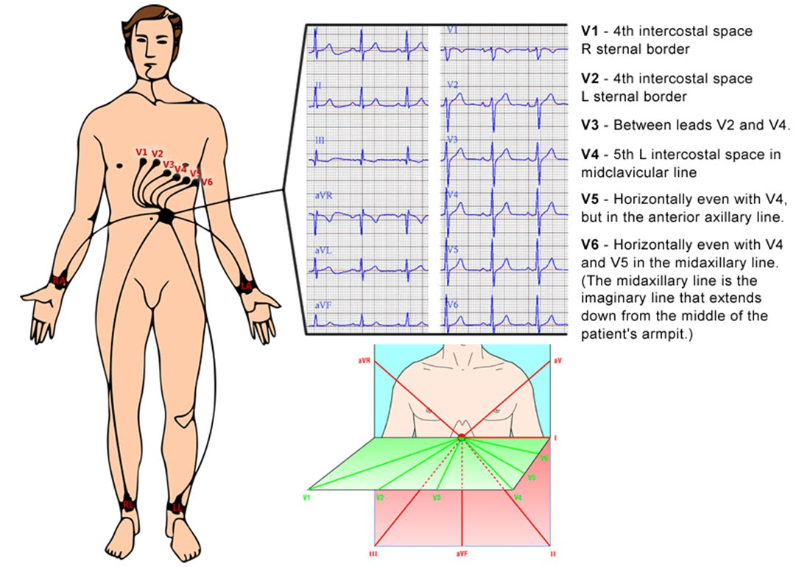
ECG Guidelines cont
ECG Guidelines (cont.)
Print ECG
Ensure date, patient name, CHI/hospital number and study ID number are printed or written on the ECG.
A doctor delegated this task on the Delegation Log should review the ECG before randomisation of participant
Doctor reviewing ECG should write any abnormal findings and actions taken in patient’s medical notes.
With the patient’s consent their GP should be informed of any abnormal findings.
File ECG in patient’s medical notes as source data

Slide 11
Physical Examination
Must be performed at screening to exclude participants with co-morbidities or other clinical disorders that would exclude from the trial.
Should be completed by a delegated doctor and documented in the participant’s medical notes as well as on the eCRF.
Examination to include:
  Respiratory
  Cardiovascular
  Abdominal
  Neurological
  Dermatological

Slide 12
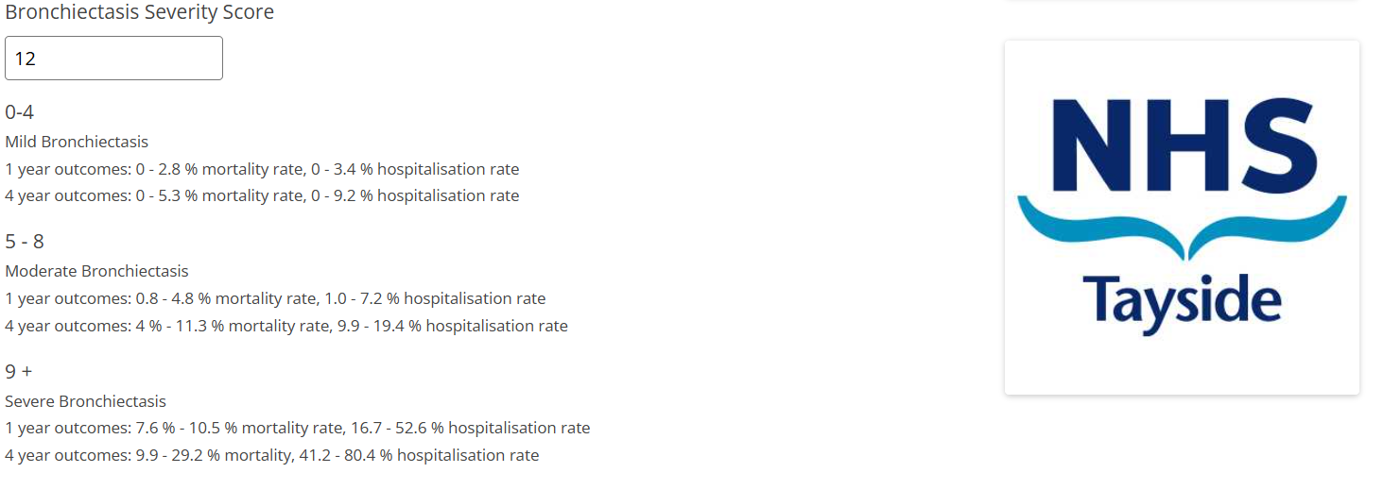
Bronchiectasis severity index
Calculate the BSI using the online calculator, the weblink is on the eCRF:
https://www.bronchiectasisseverity.com/15-2/
There must be source data in the medical notes to confirm the answers to each of the questions
Score auto calculates:

Slide 13
Questionnaires Guidelines
Questionnaires Guidelines
The latest approved version of the questionnaires should be used at all times.
Ensure the participant ID, the correct visit number and date of visit are entered on each page.
The questionnaires are intended for self-completion on the day of visit.
Answers for the questionnaires will be transcribed into eCRF (Castor) by research team.
If the respondent is unable to complete the questionnaire by themselves, it may help for the researcher to read aloud the questionnaire. It is acceptable for a third party to record the respondent’s replies but care should be taken to avoid prompting.
If the respondent finds statements too limiting - the researcher should repeat the questionnaire instruction ‘to indicate which statements best describe your own health state today’ and that there are no right or wrong answers. NB it is the respondent’s own evaluation that is required, and no prompts should be given.
If a participant has completed the questionnaire themselves or with the help of a relative/friend the researcher should check the questionnaire for completeness and go through any missing questions or ambiguous answers e.g. 2 answers ticked instead of one, go through the questionnaire with the participant. with the participant.
If a respondent has ticked 2 statements on a dimension, unless it is possible to clarify, these answers should be treated as missing data.

