Slide 1


Trial Visits

Slide 2
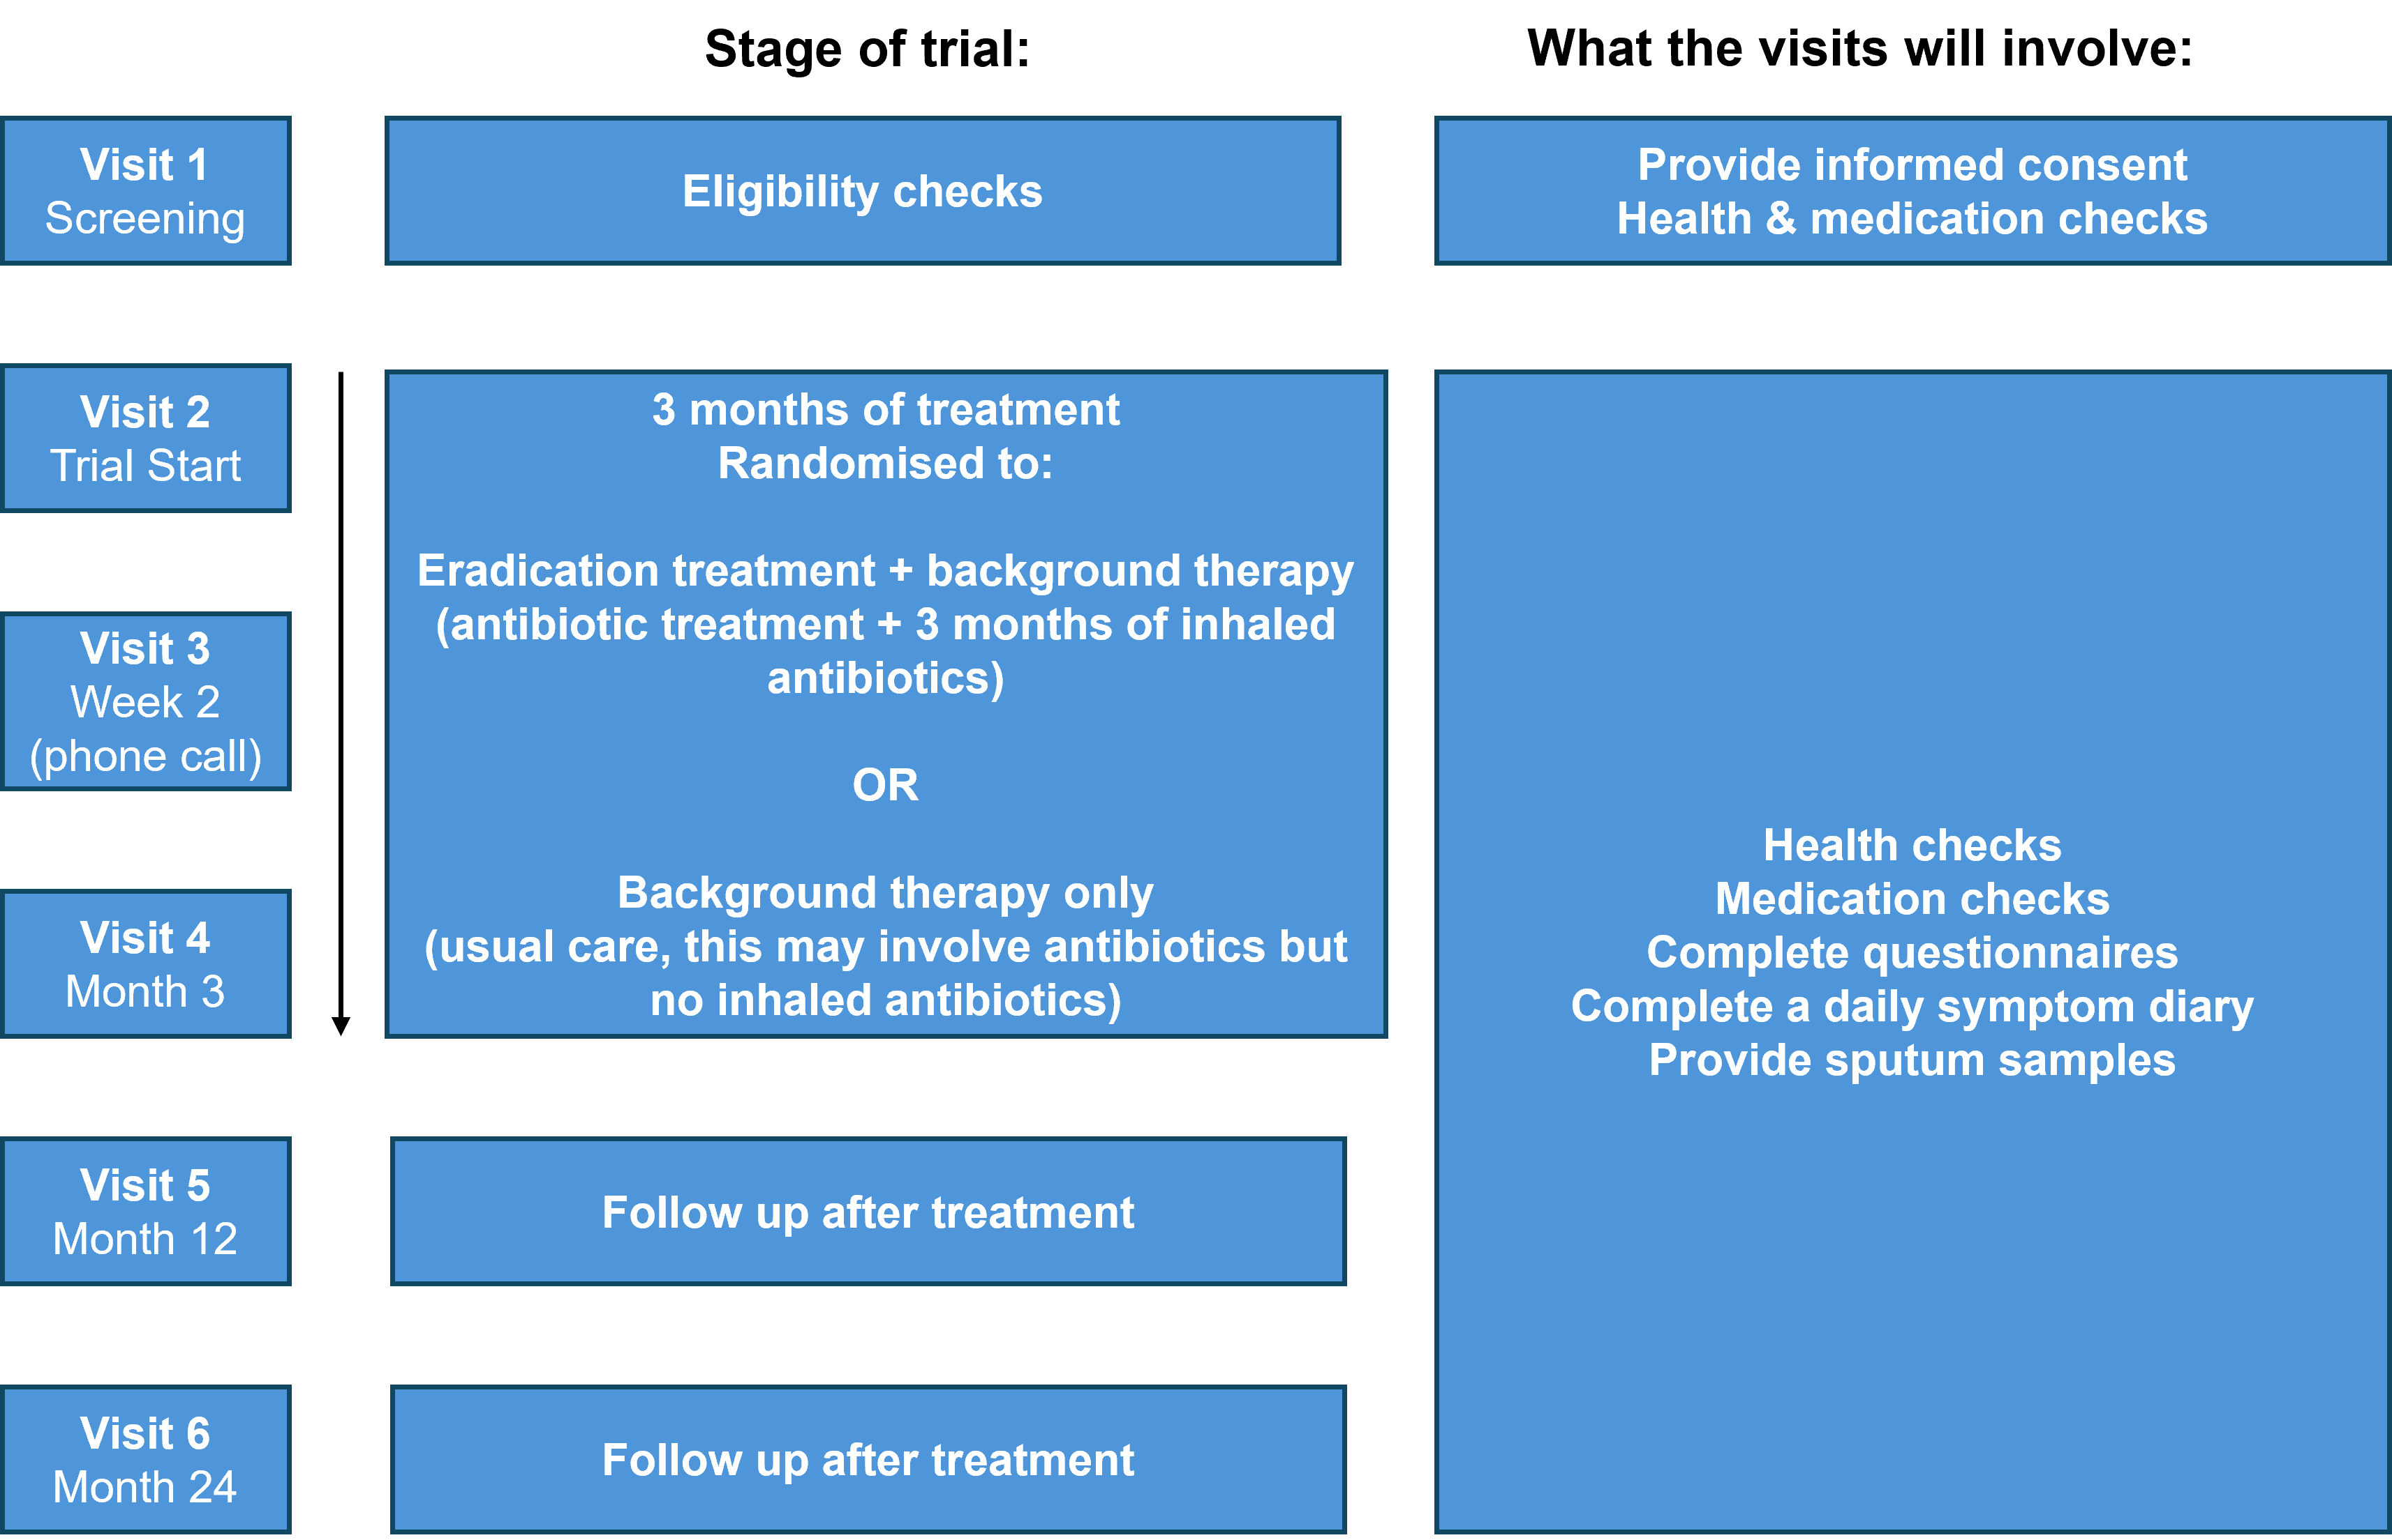
Overview of trial visits
ESCAPE is designed to be pragmatic and embedded within normal practice

Slide 3
All visits part 1
All visits
Participant Payment
Participants will not receive payment for participation, but reasonable travel expenses will be reimbursed
Participant Identity
Participant identity should be checked at each visit. Some examples of identification are listed below:
Passport
Driving licence
Current matriculation card
Young person’s or senior citizen’s railcard
Proof of Address
National Insurance Card
CHI Number/Medical Card
Scheduling Visits
Visits should take place Monday – Thursdays
If research sputum samples are posted from site to research team labs, this will ensure the sample arrives before the weekend

Slide 4
All visits part 2
All visits
Participant trial ID
All participants consented to the trial must be allocated a participant ID number
Participant ID numbers are made up of four numbers:
First two numbers to indicate the site and
Last two indicate the participant number at that site
E.g. 0101 is the first participant at site one
Use participant ID numbers in order
Ensure site ID is correct for your site
If participant fails screening, and does not go on to randomisation, their participant ID number should not be re-used
Worksheets
Worksheets are available to facilitate data collection
Their use is not mandatory
If worksheets are used to record source data, they must be filed in the medical notes

Slide 5
Trial Activities per visit
 | Visit 1 | Visit 2 | Visit 3 | Visit 4 | Visit 5 | Visit 6
 | Screening | Randomisation | Phone call | Follow-up | Follow-up | Final Visit
Informed consent | X
Eligibility check | X | X
Medical history | X
Demographics | X
Concomitant medications | X | X | X | X | X | X
Pregnancy test, if required | X
ECG | X
Weight & Height | X
Temp, BP, Pulse O₂ sats | X | X |  | X | X | X
Physical examination | X
BSI score | X
Clinical sputum sample | X* | X |  | X | X | X
Research sputum sample |  | X |  | X | X | X
QoL-B |  | X |  | X | X | X
CAAT |  | X |  | X | X | X
EQ-5D-5L |  | X |  | X | X | X
BEST diary ** (continuous throughout the trial) |  | X
Review of routine sputum culture results for P. aeruginosa |  | X | X | X | X | X
Randomisation |  | X
Prescription for trial |  | X
Exacerbation recording |  | X | X | X | X | X
Review/reporting of participant AEs/SAEs |  | X | X | X | X | X
Drug compliance |  |  | X | X

Slide 6
Visit 1 Screening (-35 days to day 0)
Informed Consent
Eligibility check
Medical history
Demographics (including demographic questionnaire)
Con meds
Pregnancy test, if required
ECG
Height & weight
Vital signs
Physical exam
Bronchiectasis severity index score
Sputum sample*
*A clinical sputum sample is only required for eligibility at visit 1 if a participant has not had a new infection of P. aeruginosa in a routine respiratory sample within the previous 6 months.
If a participant has had a positive sample for P. aeruginosa within the previous 6 months, then a separate screening visit and an eligibility sputum sample is not required, and screening & randomisation assessments can take place during the same visit.
A pregnancy test must be performed for women of childbearing potential at screening to confirm eligibility. The use of a highly sensitive urine test, performed at home and communicated to the investigators, is acceptable.

Slide 7
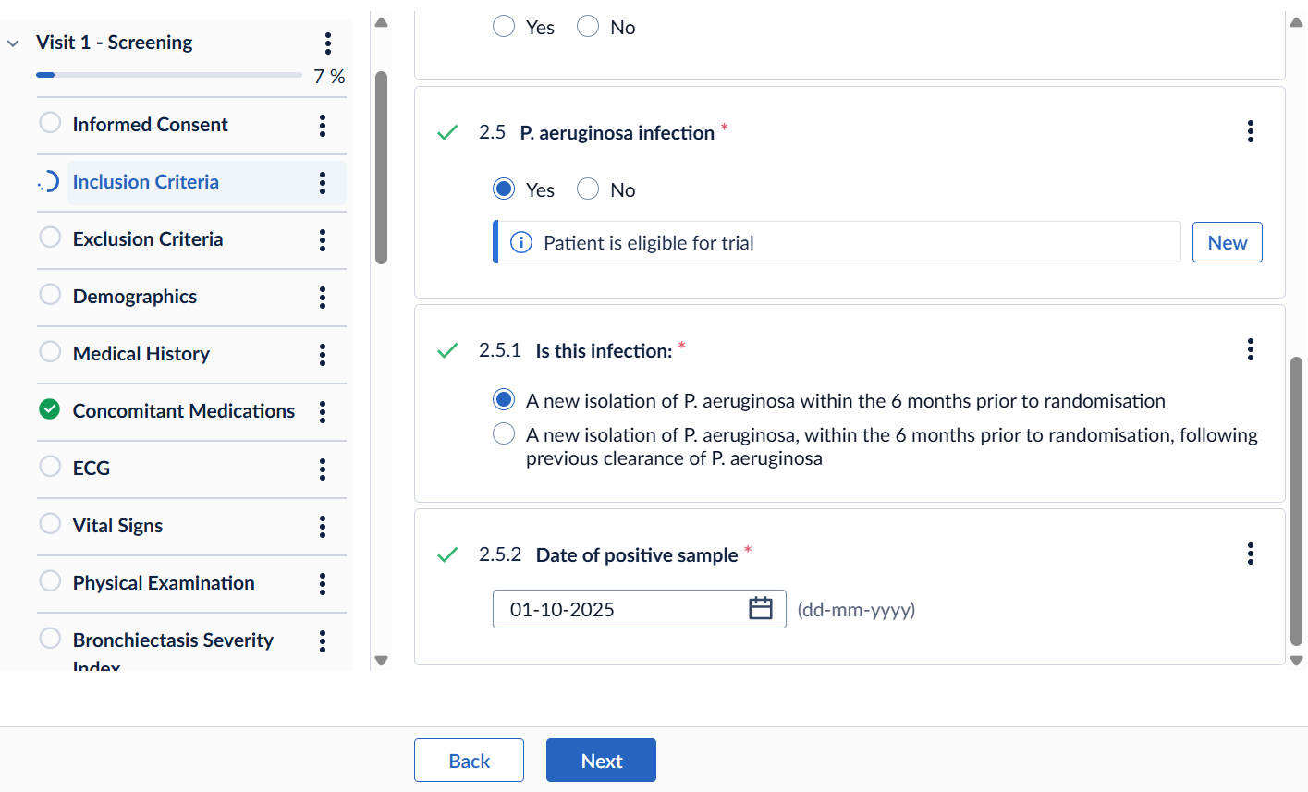
Visit 1 Screening: recording previous sputum sample
If a participant has a P. aeruginosa infection within 6 months of randomisation, the type of infection and the date of this sample should be recorded on the eCRF (Castor) under visit 1 inclusion criteria:

Slide 8
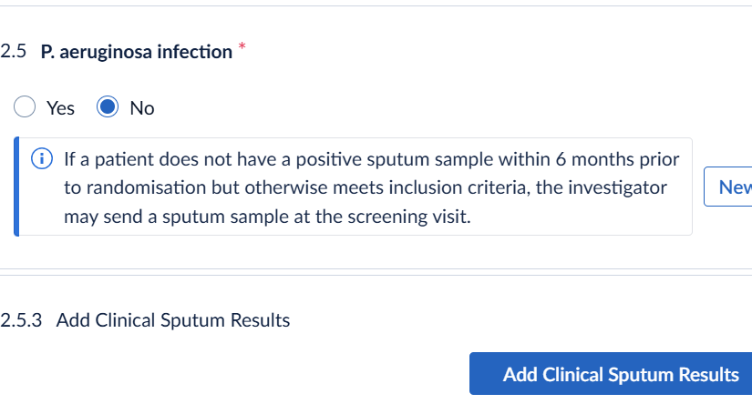
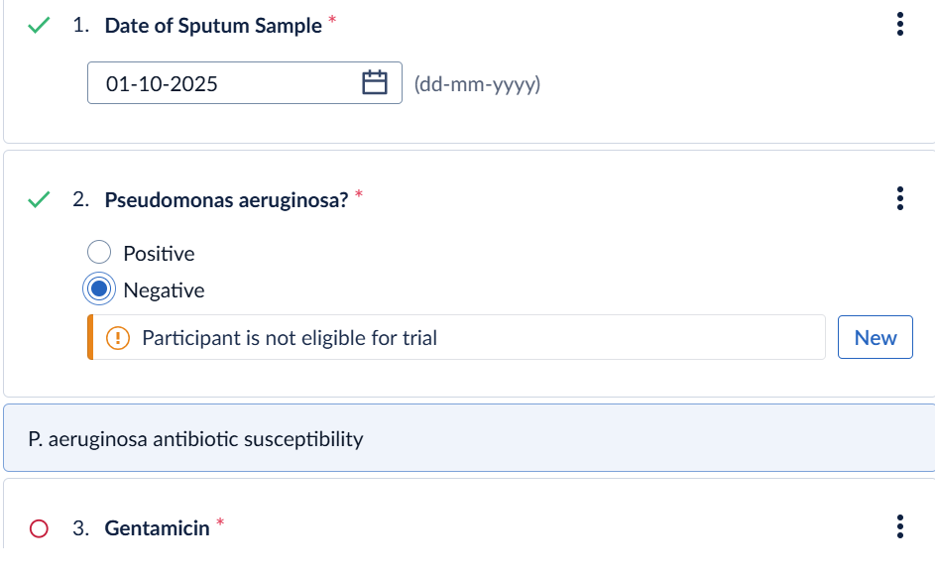
Visit 1 Screening: collecting an eligibility sputum sample
If a participant has not had a P. aeruginosa infection within 6 months of randomisation but meets all other inclusion criteria, an eligibility sample can be collected at visit 1
The eligibility sputum sample will be sent to local NHS microbiology for P. aeruginosa testing & antibiotic susceptibility testing
The results of the eligibility sample should be recorded on Castor under visit 1, inclusion criteria
Eligibility sputum sample results must be recorded on Castor before visit 2
A participant is not eligible to proceed to visit 2 if the sample is negative

Slide 9
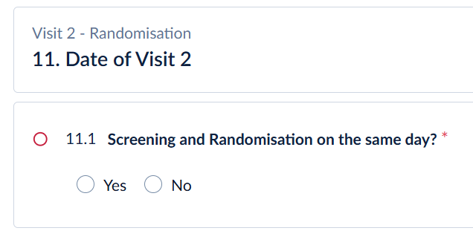
Visit 2 Randomisation (Day 0)
If the same date as visit 1, trial assessments are not duplicated
Confirm continued consent
Final eligibility check (signed by delegated doctor)
Vital signs
Record any changes to con meds
Record any AEs
Record any exacerbations
Collect clinical sputum sample
Collect research sputum sample (to be posted by research team or participant)
Review any routine sputum sample results since previous visit
Questionnaires (to be self-completed by participant during visit)
Set up BEST diary (either paper weekly symptom diary or electronic daily diary)
Randomisation
Issue prescription for trial treatment, if required

Slide 10
Visit 3 during treatment
Phone call, week 2 (+/- 3 days)
Continued Consent
Record any changes to con meds
Record any AEs
Record any exacerbations
Review any routine sputum sample results since previous visit (record on eCRF)
Review completion of symptom diary (paper or electronic)
Verbal check of trial treatment compliance (record under trial treatment form on eCRF)

Slide 11
Visit 4 end of treatment
Week 12 – 14 (+ 7 days)
For participants randomised to eradication treatment:
visit 4 should only take place after the completion of 3-months inhaled antibiotics
Continued consent
Vital signs
Record any changes to con meds
Record any AEs
Record any exacerbations
Collect clinical sputum sample
Collect research sputum sample (to be posted by research team or participant)
Review any routine sputum sample results since previous visit (record on eCRF)
Questionnaires (to be self-completed by participant during visit)
Review completion of symptom diary (paper or electronic)
Verbal check of trial treatment compliance (record under trial treatment form on eCRF)

Slide 12
Visit 5 Follow up
Week 52 (+/- 14 days)
Continued consent
Vital signs
Record any changes to con meds
Record any AEs
Record any exacerbations
Collect clinical sputum sample
Collect research sputum sample (to be posted by research team or participant)
Review any routine sputum sample results since previous visit (record on eCRF)
Questionnaires (to be self-completed by participant during visit)
Review completion of symptom diary (paper or electronic)

Slide 13
Visit 6, Final Assessment
Week 104 (+/- 14 days)
Continued consent
Vital signs
Record any changes to con meds
Record AEs
Record any exacerbations
Collect clinical sputum sample
Collect research sputum sample (to be posted by research team or participant)
Review any routine sputum sample results since previous visit (record on eCRF)
Questionnaires (to be self-completed by participant during visit)
Review completion of symptom diary (paper or electronic)

Slide 14
Visit windows
Visit windows
Missed trial assessments or trial medication, or visits completed outside the visit window, will not be reported as breaches, where this is due to participant choice or a clinical decision.
† For participants randomised to receive eradication treatment, visit 4 should take place within 7 days of the completion of inhaled antibiotic treatment. Those randomised to background thera, visit 4 should take place at 12 weeks (+7) days.
Visit 1 | Visit 2 | Visit 3 | Visit 4 | Visit 5 | Visit 6
Screening | Randomisation | Phone call | Follow-up assessments | Follow-up assessments | Final Assessments
Day -35 to 0 | Day 0 | Week 2 (+/- 3 days) | † Week 12 – 14 (+ 7 days) | Week 52 (+/- 14 days) | Week 104 (+/- 14 days)

