Slide 1

Introduction
ESCAPE: Investigating whether prolonged antibiotics can prevent permanent Pseudomonas infection in bronchiectasis
Exacerbation and Symptom Control After Pseudomonas Eradication Treatment in Adult Bronchiectasis: a multicentre randomized controlled trial
CI: Professor James Chalmers, University of Dundee
Trial Management: Tayside Clinical Trials Unit, University of Dundee
Sponsor: University of Dundee & NHS Tayside
NIHR Funded

Slide 2
Background
Bronchiectasis is a debilitating chronic respiratory disease characterised by cough, sputum production and associated with cycles of lung inflammation and infection
Pseudomonas infects the lungs of around 1/3 of all people with bronchiectasis
Pseudomonas can be resistant to many antibiotics, causing infection in the lungs that is difficult to get rid of
This means that people can become permanently infected with Pseudomonas
British Thoracic Society have a conditional recommendation of “eradication treatment”
Combination of systemic (oral or intravenous) antibiotics + 3 months of inhaled antibiotics
No standard approach to treatment & no evidence whether eradication treatment is effective
Testing efficacy of the eradication approach compared to background therapy only

Slide 3
Trial Design
ESCAPE is categorised as a CTIMP, however not a traditional CTIMP
Randomising to two treatment pathways, using medications already used in routine practice
Due to safety requirements, IMPs for the intervention arm (eradication treatment) are defined in the protocol
Only antibiotics defined in the protocol can be prescribed for the intervention: eradication treatment
Treatment prescribing will be determined by the local clinician following usual practice and the British Thoracic Society Guidelines
Treatments will be issued through routine prescription & NHS pharmacy from local stock
No IMP provided to site, no clinical trial pharmacy involvement

Slide 4
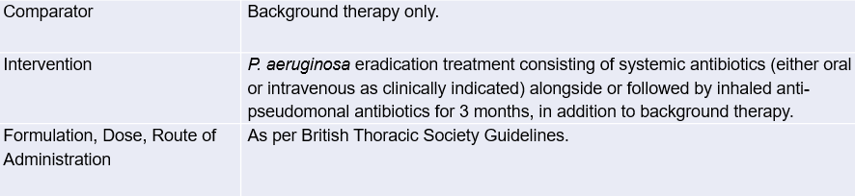
Treatment allocation
Participants randomised to one of two treatment pathways:
Background therapy (comparator) or eradication treatment (intervention)
This trial is aimed at assessing efficacy, safety and cost effectiveness of P. aeruginosa eradication treatment compared with background therapy only in current clinical practice in the UK.

Slide 5
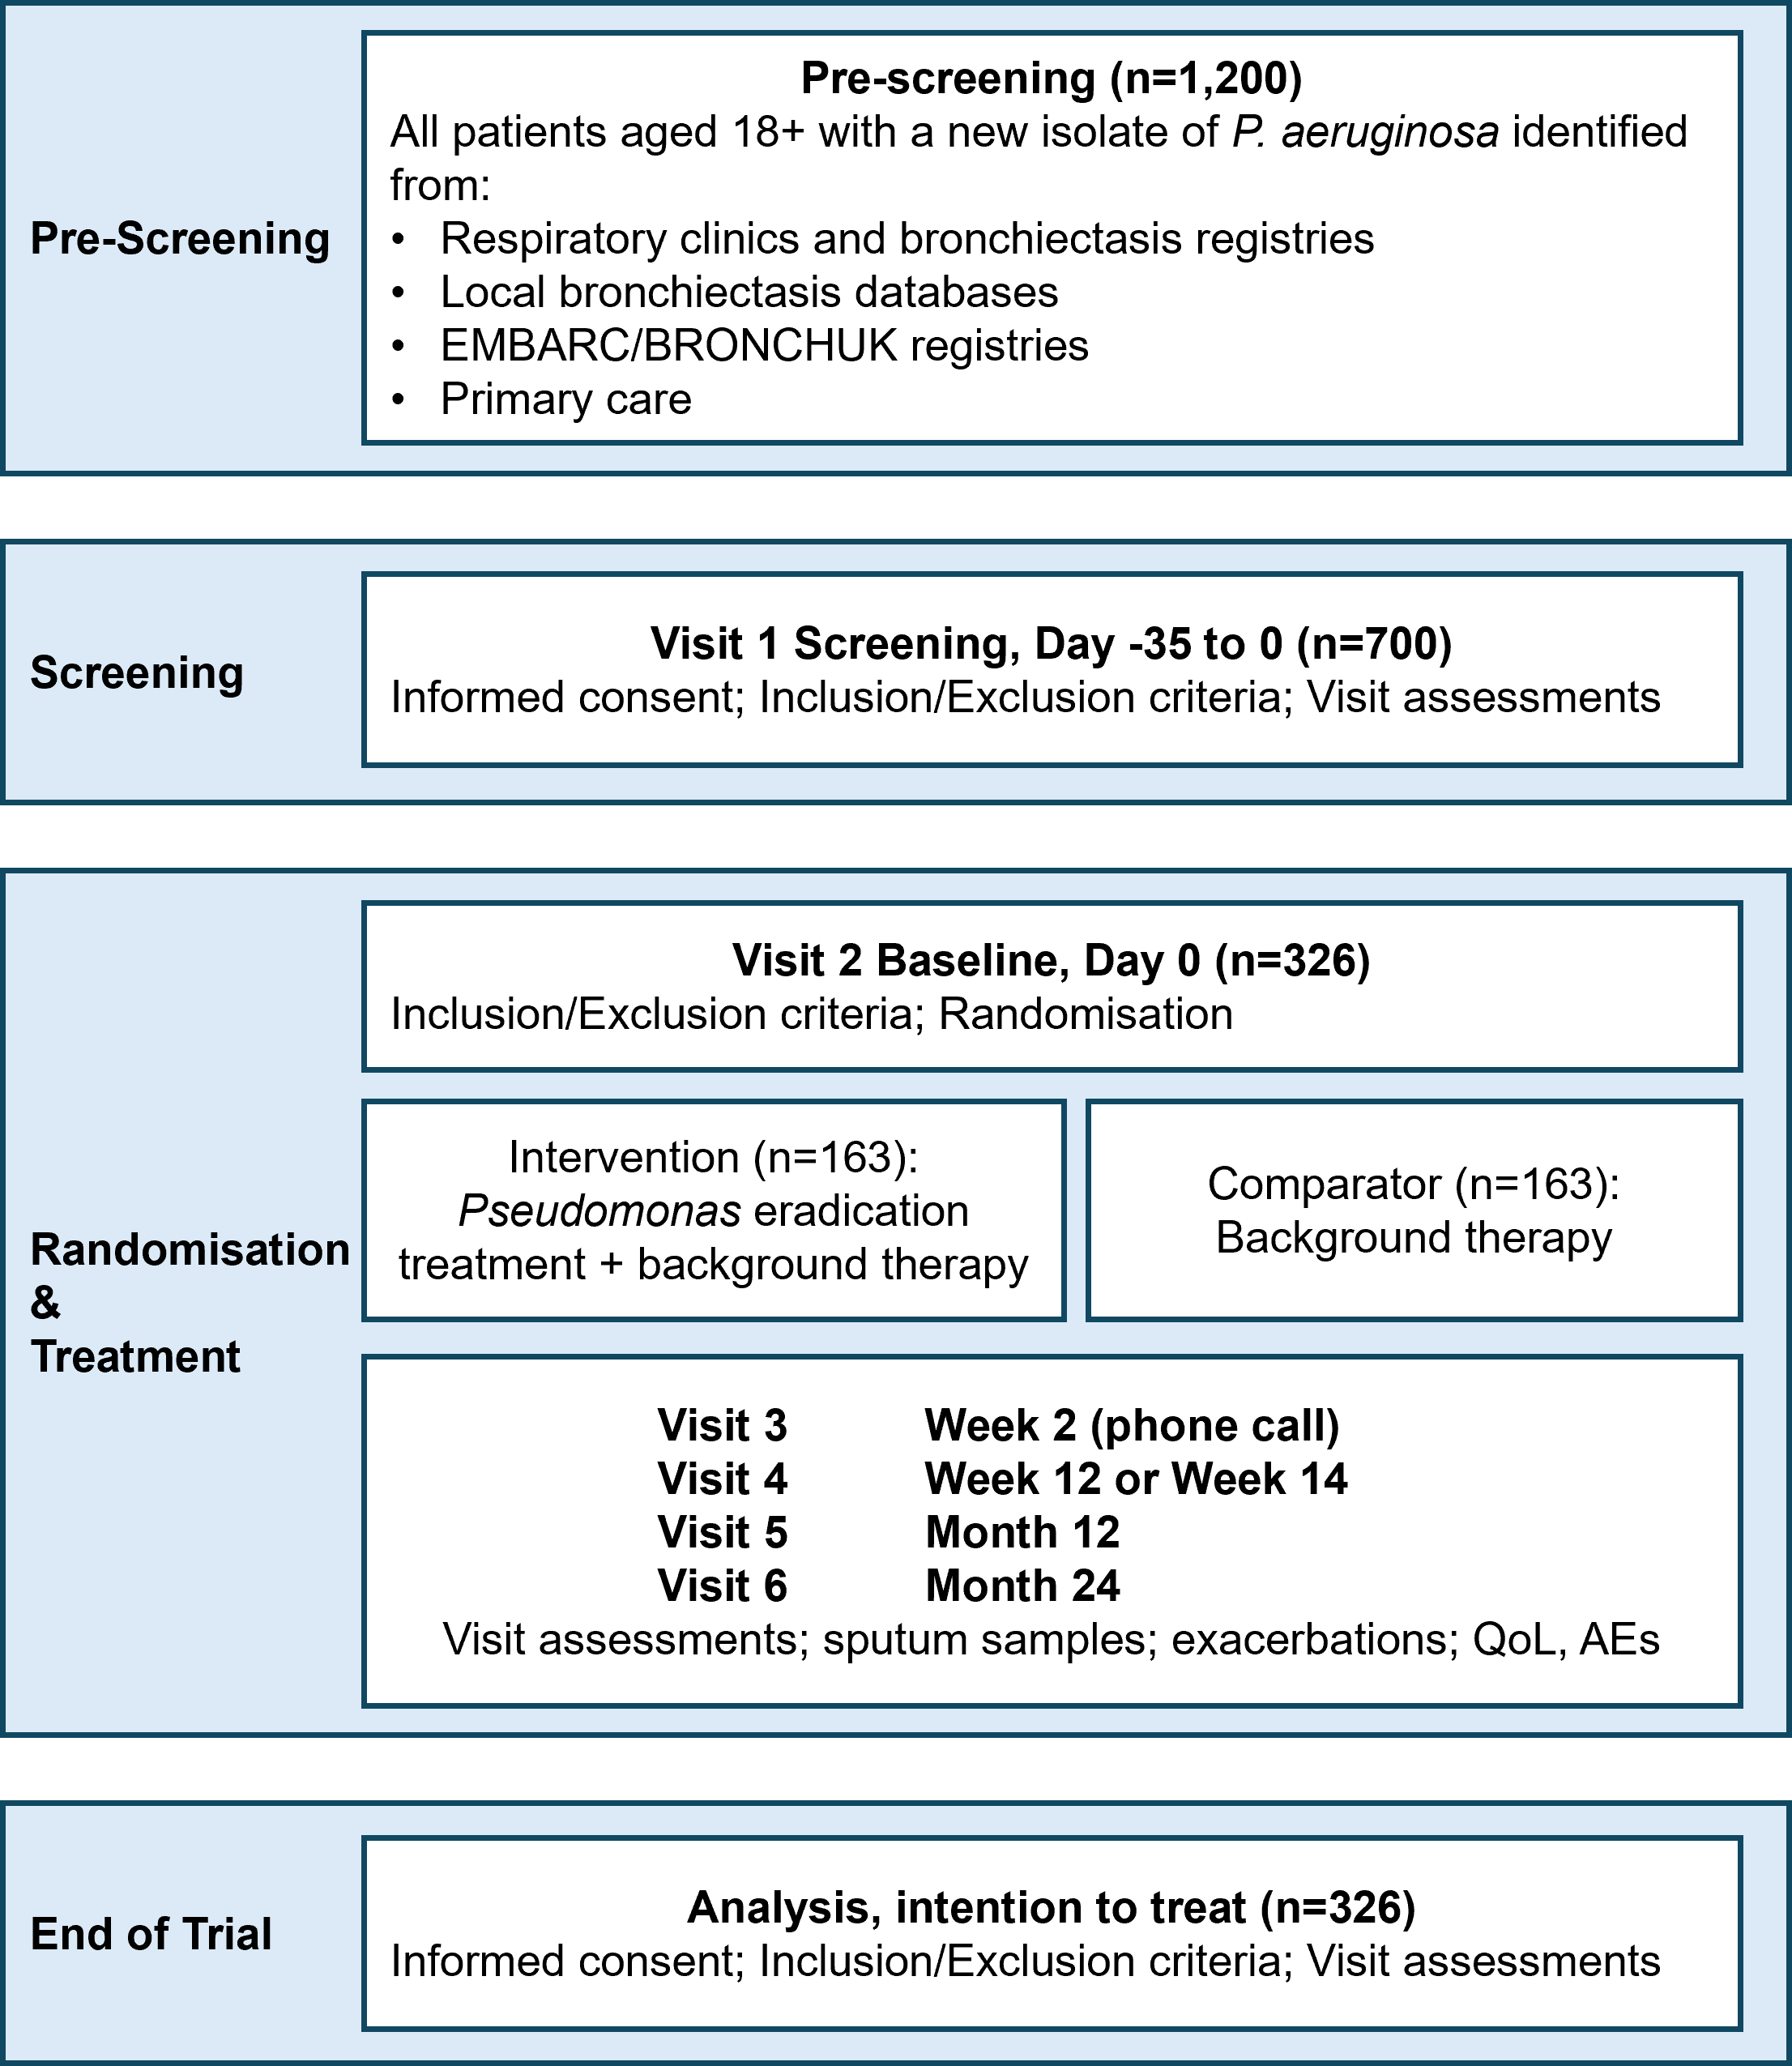
Trial Flow Chart

Slide 6

Primary Objective
To evaluate the effect of P. aeruginosa eradication treatment compared with standard care excluding inhaled antibiotics on rate of exacerbations
Outcome Measure:
Frequency of pulmonary exacerbations (EMBARC definition)
Timepoint
From day 0 to week 104 (2 years, end of trial)
Research Questions
Is there a difference in the rate of exacerbations over 24 months in patients given P. aeruginosa eradication treatment compared to patients receiving background therapy only?
2) What are the costs and consequences of P. aeruginosa eradication treatment and is it cost-effective when compared to patients receiving background therapy only?

Slide 7
Secondary Objectives
Secondary Objectives
Objective | Outcome measure
To evaluate the cost-effectiveness of P. aeruginosa eradication treatment compared with standard care | Frequency of pulmonary exacerbations (EMBARC definition)
 | Incremental cost per exacerbation prevented
 | Incremental cost per quality adjusted life year (QALY) gained.
To evaluate the effect of P. aeruginosa eradication treatment compared with standard care excluding inhaled antibiotics on eradication of P. aeruginosa | Frequency of P. aeruginosa isolation in sputum samples
To evaluate the effect of P. aeruginosa eradication treatment compared with standard care excluding inhaled antibiotics on hospitalisation | Hospitalisations for severe exacerbations
To evaluate the effect of P. aeruginosa eradication treatment compared with standard care excluding inhaled antibiotics on quality of life | Quality of life-bronchiectasis (QOL-B) respiratory symptom scale
 | Chronic Airways Assessment Test (CAAT)
 | Quality of life using the EQ-5D-5L
 | Bronchiectasis exacerbation and symptom tool (BEST) diary
To evaluate the effect of P. aeruginosa eradication treatment compared with standard care excluding inhaled antibiotics on reinfection rates | Time to reinfection (isolation of P. aeruginosa after a first negative sputum sample)
To evaluate the effect of P. aeruginosa eradication treatment compared with standard care excluding inhaled antibiotics on antibiotic use | Total days of antibiotic use

Slide 8
Secondary Objectives part 2
Secondary Objectives
Objective | Outcome measure
To evaluate the effect of P. aeruginosa eradication treatment compared with standard care excluding inhaled antibiotics on antibiotic resistance | P. aeruginosa antibiotic resistance
To evaluate the effect of P. aeruginosa eradication treatment compared with standard care excluding inhaled antibiotics on healthcare usage | All-cause healthcare contacts
To evaluate the effect of P. aeruginosa eradication treatment compared with standard care excluding inhaled antibiotics on death | All-cause mortality
To evaluate the effect of P. aeruginosa eradication treatment compared with standard care excluding inhaled antibiotics on adherence to treatment | Treatment adherence
To evaluate the effect of P. aeruginosa eradication treatment compared with standard care excluding inhaled antibiotics on safety | Frequency of adverse events (AEs) and serious adverse events (SAEs)
To evaluate the effect of P. aeruginosa eradication treatment compared with standard care excluding inhaled antibiotics on use of long term inhaled antibiotic treatment | Time to commencement of long term inhaled antibiotic treatment
Exploratory Objectives
Objective | Outcome measure
To evaluate the detection of P. aeruginosa using molecular laboratory methods | P. aeruginosa abundance measured by molecular laboratory tests

Slide 9
Trial timelines
Recruitment period: from site activation – May 2028
The last patient last visit: May 2030
End of trial: November 2030
The trial will recruit 326 participants across 50 sites in the UK
NIHR have 18-month pilot phase to review site set up & recruitment rates
Recruitment is key in the first 12 months of the trial

Slide 10
Contacting trial team
Trial is co-sponsored by University of Dundee & NHS Tayside
Trial management by Tayside Clinical Trials Unit (TCTU)
Contract the trial team:
Trial queries: ESCAPE-TM@dundee.ac.uk
Data queries: ESCAPE-DM@dundee.ac.uk
Trial coordinator mobile: 07818 511117
Due to large number of sites, please title emails:
ESCAPE (site name) (summary of query) when contacting us

