Slide 1


Identifying Participants, Screening & Eligibility

Slide 2
Communication Guide
Communication Guide
Developed an ESCAPE communication guide with patient partners
Please review this before discussing the trial with potential participants
Covers:
Why are we doing the trial
Trial design
Treatment options
Why we need to randomise to a treatment pathway
What will happen if they choose / do not choose to take part

Slide 3
Inclusion Criteria
Inclusion Criteria
  1. Adults (18 years or older)
  2. Able to provide informed consent.
  3. Capable of complying with all trial procedures and of completing the trial, in the opinion of the investigator.
  4. Bronchiectasis, confirmed by computed tomography (CT), showing bronchiectasis in 1 or more lobes (a historical radiology report or report from the investigator confirming bronchiectasis is sufficient for enrolment) and the appropriate clinical syndrome (symptoms of cough, sputum production and/or respiratory tract infections).
  5. Able to be prescribed one of the inhaled antibiotics defined in the intervention arm, in the opinion of the investigator.
  6. P. aeruginosa infection confirmed by:
  6.1) New isolation of P. aeruginosa, defined as the first documented sputum or other respiratory tract sample e.g. bronchoalveolar lavage samples) positive for P. aeruginosa within the 6 months prior to randomisation
  OR
  6.2) New isolation of P. aeruginosa, within the 6 months prior to randomisation, following previous clearance of P. aeruginosa defined as a minimum of 12 months without a positive P. aeruginosa culture and at least 2 intervening cultures negative for P. aeruginosa.
The investigator will take into account contraindications when determining both participant eligibility and the choice of antibiotic for each individual participant.
If a participant does not have a positive sputum sample within 6 months prior to randomisation but otherwise meets inclusion criteria 1 to 5, the investigator may send a sputum sample at the screening visit. If the participant is positive for P. aeruginosa then the inclusion criteria are met.

Slide 4
Exclusion Criteria
Exclusion Criteria
Current treatment with inhaled antibiotics or treatment with inhaled antibiotics within the previous 6 months
Chronic P. aeruginosa infection defined as isolation of P. aeruginosa persistently in sputum, or the absence of negative sputum samples for P. aeruginosa so that inclusion criteria (6) above cannot be met
Cystic fibrosis
Use of any investigational drugs within five times of the elimination half-life after the last dose or within 30 days, whichever is longer. Current enrolment in non-interventional, observational studies will be allowed
Currently pregnant or breast-feeding
Unstable co-morbidities (e.g., cardiovascular disease, active malignancy) which in the opinion of the investigator would make participation in the trial not in the participant’s best interest
Estimate eGFR<30 or abnormal liver function tests that in the opinion of the investigator make antibiotic treatment inappropriate (note that the trial is designed to be pragmatic and embedded within normal practice therefore testing is at the discretion of the managing clinician)
A strong preference, either from the managing clinician or the participant, for one of the two trial arms such that in the opinion of the investigator adherence to the trial protocol would not be possible.
Previous intolerance to inhaled antibiotics is not an exclusion from the trial, but participants should be prescribed a different inhaled antibiotic to one that was previously not tolerated. If no antibiotic treatment options for the active arm are available/possible, then the participant should be excluded.
Coexisting asthma, COPD or other respiratory diseases are allowed as long as the participant also meets the inclusion criteria related to radiological and clinically significant bronchiectasis.
Participants may have received antibiotic treatment (including antibiotic treatment against P. aeruginosa) in the previous 6 months as long as this antibiotic treatment did not include an inhaled antibiotic.
If the participant already has a positive sputum sample within the previous 6 months, a positive sputum sample for P. aeruginosa is not required at screening following antibiotic treatment.

Slide 5
Participant Identification and pre screen
Participant Identification & Pre-screen
Identification of potentially eligible trial participants by the research or clinical teams may make use of any or all of the following:
From secondary care via contact with participants at specialist respiratory clinics or pulmonary rehabilitation classes.
From local Bronchiectasis databases where participants have given prior consent to be contacted for future research projects, e.g. EMBARC registry, or local registers such as TAYBRIDGE, BRONCH-UK, or similar databases with appropriate approval in other NHS facilities as defined locally.
With appropriate local Caldicott Guardian approval and arrangements with microbiology laboratories investigators may make use of notification from local microbiology laboratories of individuals who have recently tested positive for P. aeruginosa in a respiratory tract sample.
Recruitment of participants registered via the Scottish Health Research Register (SHARE)
From primary care practices or via the Primary Care Networks.
From participant identification centres (PICs). An agreement between the research site and PIC centre will be put in place.

Slide 6
Participant identification and pre screen continued
Participant Identification & Pre-screen
Potential participants identified from clinic lists:
Clinical team will review the potential participant medical notes to see if they are potentially eligible (Pre-screen)
If identified at clinic, a member of the clinical team will give the patient a copy of the brief Participant Information Sheet (bPIS)
The clinical team will pass on potential participant details to the research team
Potential participant details added to pre-screening log
Potential participants identified from locally held databases/SHARE:
Research team check the potential participant medical notes to see if they meet eligibility criteria
Check screening log to ensure potential participant has not been approached in clinic
Database invitation letter and bPIS sent to potential participant
Potential participant details added to pre-screening log
Potential participants identified from primary care:
Participants will be sent an invitation letter and bPIS from the GP practice. GP practices will also be asked to display bPIS in their waiting rooms

Slide 7
Consent timeline
Consent timeline
Participants must receive the participant information sheet prior to giving consent and be given sufficient time to review the trial information and ask questions, this is usually at least 24 hours.
The trial is designed to be pragmatic and fit into usual care.
If participants are identified in clinic, it is acceptable to take consent on the date the participant is identified, the consent process must be fully documented in the medical notes.
This should document that the participant was given the opportunity to return at a later date for their first research visit, had the opportunity to ask questions and that it was the participant’s decision to provide consent and complete their first research visit on the same date as receiving the participant information sheet.

Slide 8
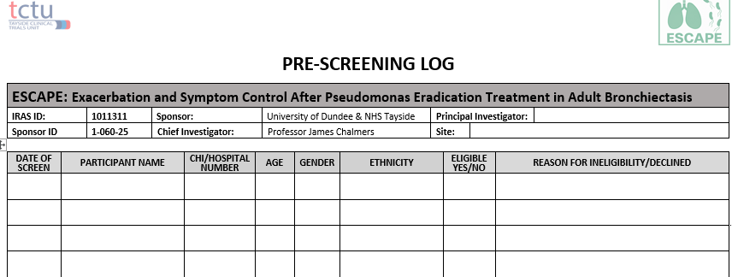
Pre screening log
Pre-screening Log
Details of all participants reviewed for eligibility for screening to be recorded on the pre-screening log
Anonymised information on participants who are consented but not randomised will be collected for CONSORT reporting and includes:
age
gender
ethnicity
the reason not eligible for trial participation, or if they are eligible but declined

Slide 9
Eligibility assessment
Eligibility Assessment
Assessment of eligibility will be carried out by the PI or other medically qualified delegate
at visit 2, prior to randomisation
Eligibility form must be completed & signed by delegated doctor before randomisation
If a participant is ineligible
Record reason for ineligibility
Where an ineligible participant’s medical condition or concomitant medications change sufficiently so that they are deemed potentially eligible for the trial they may be rescreened one further time.

Slide 10
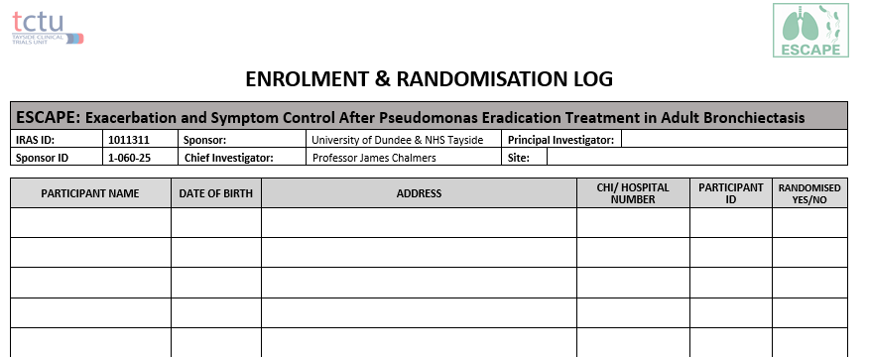
Enrolment and randomisation log
Enrolment & Randomisation Log
All participants who are consented and randomised should be added to the enrolment log

Slide 11
Reporting screening and enrolment figures to the trial management team
Reporting Screening & Enrolment Figures to the Trial Management Team
Trial management team will request monthly figures (no identifiable data will be requested, numbers only)
This will be used for a Screening, Enrolment & Randomisation report for monthly trial management group meetings
Funder also requires monthly screening & recruitment updates

