Slide 1
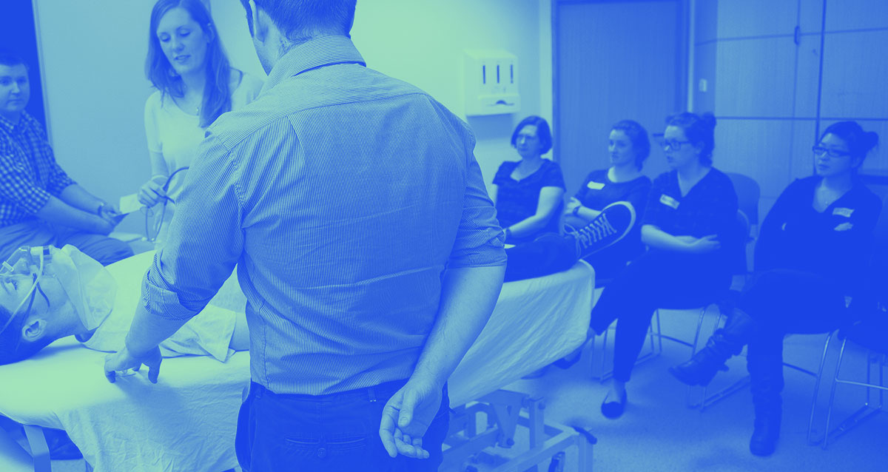
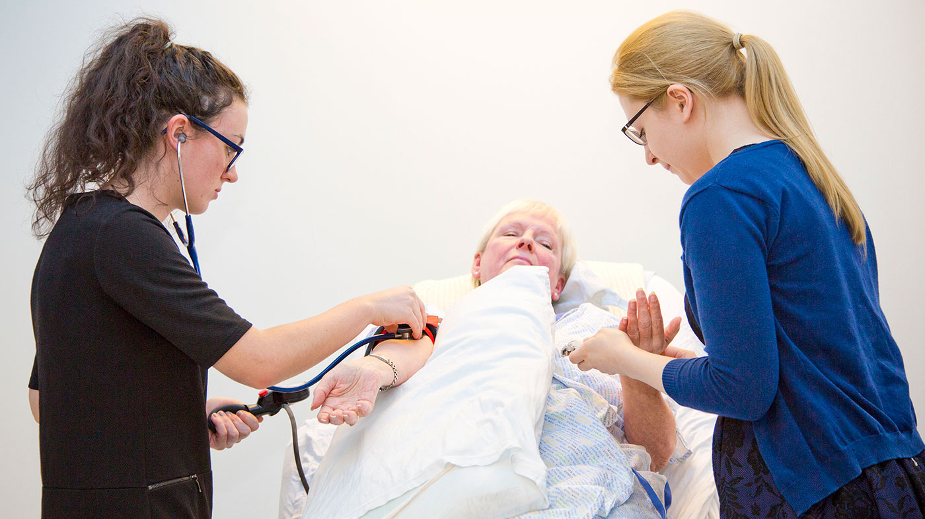
My Career Journey
Stephen Bruce
Learning Design and Technology Lead
November 2025

Slide 2
Technologies
VLEs (First class, WebCT Campus, Vista, Moodle)
Turnitin (Be wise)
eSubmission of coursework
Lecture Capture
Learning Analytics
Polling
Covid – exams online and Webex

Slide 3
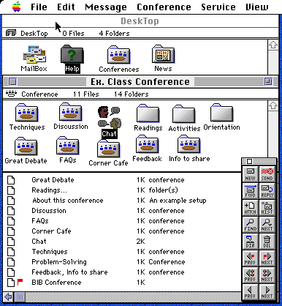
Reminder to students
Graphic images & color - Color graphics and scanned images can be posted and viewed on-line in full-sized windows with text annotation. Text can be written in multiple colors, fonts, font sizes, and other standard formats (e.g. fonts & styles).
Document editing - Multiple users can create and edit on-line text documents (asynchronously) to write collaborative documents.
Flagged Unread messages - When a message is sent to a conference, the conference is flagged to help each user locate his/her unread messages across multiple conferences .
Message threading - Users can separate and follow messages between multiple lines of discussions within a conference using a forward and backward threading function. In addition, the graphic user interface allow users to sort and view messages by icon, date, author, subject, size, and status (read & unread).
File Attachments - File sharing is accomplished by attaching files (e.g. Excel spreadsheets, word documents, graphic files) to messages or by directly uploading files to the server.
Live conferencing
Notes:
FirstClass conferencing is an electronic client-server communication system (by SoftArc®). It combines the functions of both email, bulletin board and file server to allow conference owners to control and structure an electronic setting for group and person-to-person communication over the Internet.

Slide 4
Learning Outcomes
By the end of the session, students will be able to:
  Describe how to use a critical… bullet point (20pt)
  Apply the principles of… bullet point (20pt)
  Clinical Problems related to… bullet point (20pt)

Slide 5
Notes about this template
  This template has been developed to provide a consistent approach across the Medical School. It meets current University branding guidelines and should not be amended.
  The colours used (eg in graphs, charts, boxes, text highlight) are the brand colours and should be used for consistency.
  To replace imagery, delete the placeholders and click the ‘picture icons’ to browse for alternatives.
  If you wish to add a footer to your document, please go to ‘Insert’ tab > Header & Footer, to access the settings.
  The display ratio is set to 16:9 - please do not change this to 4:3 as headings and styles will no longer work. An alternative 4:3 version of this template is also available.

Slide 6
Slide for dark images only

Slide 7
Two column layout

Slide 8
Multiple content layout (3)

Slide 9
Accessibility guidelines
  To make it easier for anyone with a visual impairment to access information on slides, any images or charts that are used should have Alt Text for each.
  To add Alt Text right click on the image, and select “Size and Position”.
  At the bottom of the right hand side panel that opens up, there is an option for Alt Text. The Title should be a brief description of what the image is, and the Description should be a written description of whatever the image is showing.
  For any images with embedded text, charts or figures, the description needs to contain everything that the image shows, as someone who cannot physically see the image themselves will not be able to get anything out of those slides at all, even with Accessibility software such as a screen-reader.

Slide 10
dundee.ac.uk

